Slide 1


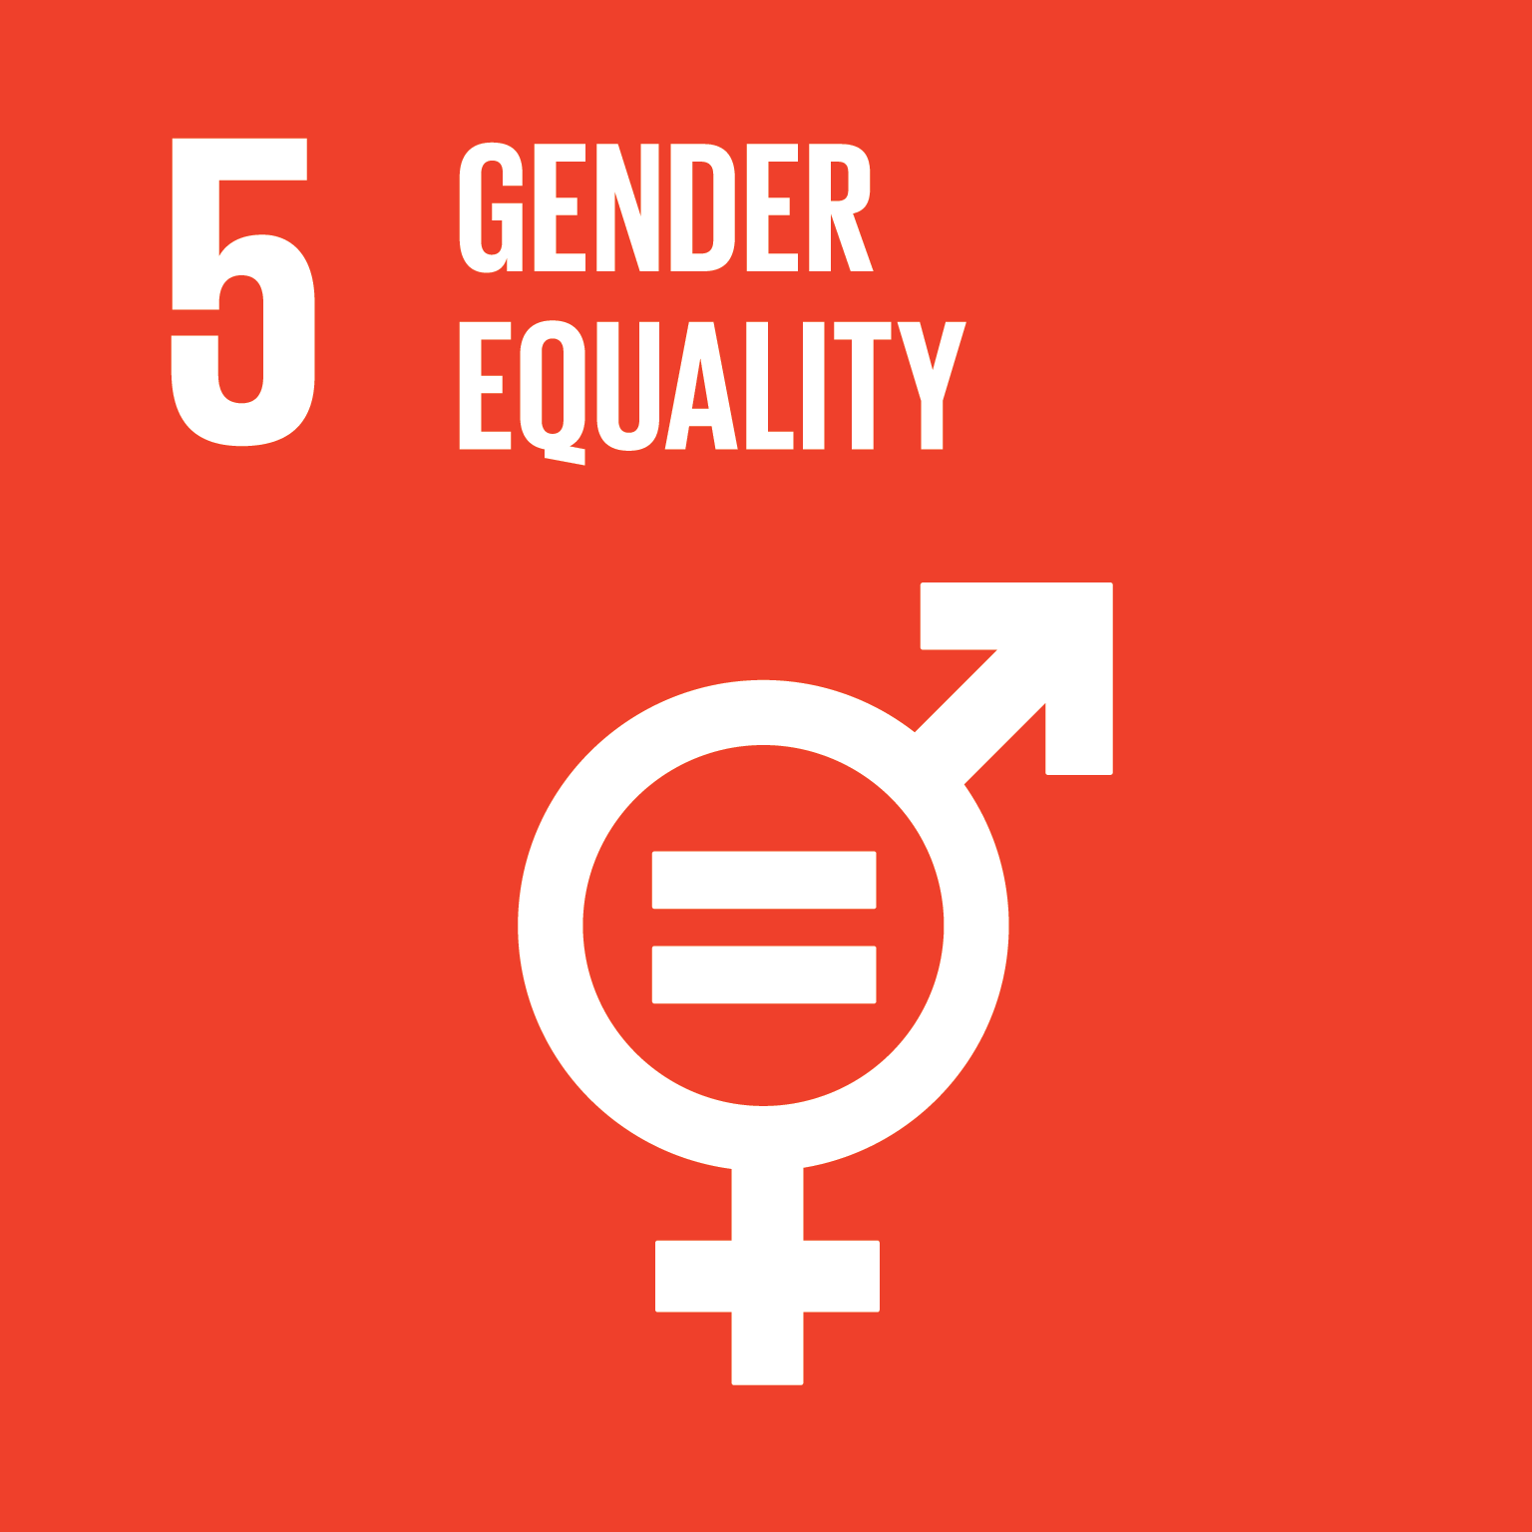
Socio-Cultural Perspectives on Conflict and Peace:
with an emphasis on Gender
Webinar
Dr. Brittany Foutz
Dr. Chris Kwaja
Mrs. Alexandra Ginta-Martin, M.A.
Dr. Brian Polkinghorn
Ms. Francesca Falasca, Bachelor’s in Law
Ms. Brittany Bursa, B.A.
Ms. Iye Ogbe, M.S.
Ms. Hannah Prouse, B.A.
Ms. Shannon Rommel, B.A.
Ms. Cassandra Duncan
Ms. Sandra Zelaya
Ms. Erin Karrh
This training is, also, approved and acknowledged by: Western Sydney University, RCE Greater Western Sydney (RCE-GWS) .

Slide 2

RCE Salisbury
-Housed within the Bosserman Center for Conflict Resolution, Salisbury, Maryland (USA)
-Directors: Dr. Brittany Foutz and Dr. Brian Polkinghorn
-Conflict prevention and creative problem solving
Image from: http://bossermancenter.com/.

Slide 3
Bosserman Center of Conflict Resolution
Executive Director Dr. Brian Polkinghorn
Promotes peace and conflict resolution
Offers the United Nations Educational, Scientific and Cultural Organization (UNESCO) Fellowship Program
Is known as RCE Salisbury through UN University and UNESCO
Offers United Nations Institute for Training and Research (UNITAR) Training
Conducts research of peace and conflict issues
Attracts and implements grant funded projects, contracts, and consultancies
Disseminates findings and educates the public through conferences, training, and workshops

Slide 4
Our Social Media
http://bossermancenter.com/
Facebook: United Nations Association Salisbury Chapter - RCE Salisbury
https://www.facebook.com/United-Nations-Association-Salisbury-Chapter-RCE-Salisbury-414706622623935
Instagram Name: unassociationsalisbury

Slide 5
Introduction of the Trainers
Dr. Brittany Foutz
Dr. Chris Kwaja
Mrs. Alexandra Ginta-Martin, M.A.
Dr. Brian Polkinghorn
Ms. Francesca Falasca, Bachelor’s in Law
Ms. Brittany Bursa, B.A.
Ms. Iye Ogbe, M.S.
Ms. Hannah Prouse, B.A.
Ms. Shannon Rommel, B.A.
Ms. Cassandra Duncan
Ms. Sandra Zelaya
Ms. Erin Karrh

Slide 6
Dr. Brittany Foutz
Visiting Professor of the Department of Conflict Analysis and Dispute Resolution at Salisbury University
Co-Director of Salisbury Regional Centre of Expertise
Ph.D. in International Conflict Management from Kennesaw State University
Wrote her dissertation on “Victim Satisfaction with Reparations from the International Criminal Court: An Examination of Child Soldier Cases from Kenya and the Democratic Republic of Congo”,
Served for two years as the Program Manager for the United Nations International Training Centre for Authorities and Leaders (CIFAL)

Slide 7
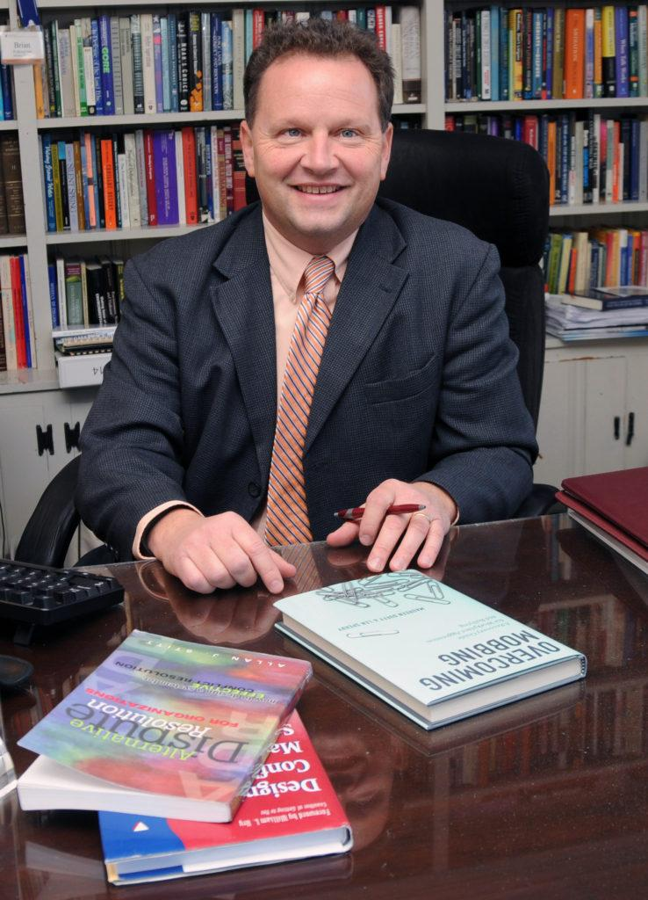
Dr. Brian Polkinghorn
Distinguished Professor of Conflict Analysis and Dispute Resolution
Founding faculty member in the Department of Conflict Analysis and Resolution, Nova Southeastern University (1994-2000)
Program Director and founding faculty member in the Department of Conflict Analysis and Dispute Resolution
Executive Director of the Bosserman Center for Conflict Resolution
Published 50+ articles, book chapters and books and has been the principal investigator or recipient of more than 70 research and service grants
Alum of the School for Conflict Analysis and Resolution (SCAR), George Mason University
Serves on their Board of Advisors and the Program on the Analysis and Resolution of Conflicts (PARC)
Fellow with the Program on Negotiation, Harvard University Law School (1991-1992)
Senior American Fulbright Scholar with the Evens Program in International Conflict Resolution and Mediation at Tel Aviv University (2010)
Currently a Fulbright Alumni Ambassador with the Institute of International Education and the Council for International Exchange of Scholars.

Slide 8
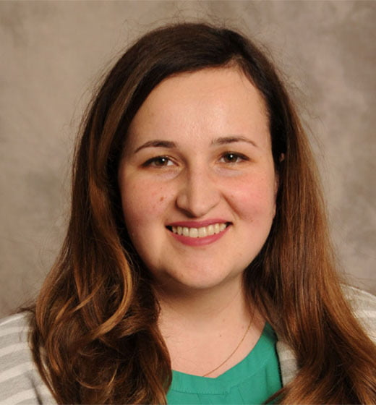
Alexandra Ginta-Martin, M.A.
Adjunct faculty member in the Conflict Analysis and Dispute Resolution Department at Salisbury University
Senior Research Fellow and practitioner at the Bosserman Center for Conflict Resolution since 2016
Academic background in International Relations and European Studies, with a distinct focus on diplomacy and foreign affairs
Professional interests gravitate strongly around organizational conflict resolution, fair practices, equal employment and educational opportunity
Has been serving as a Title IX and EEO Investigator at the University of Maryland Eastern Shore
Was involved in outreach initiatives and information campaigns directed at underrepresented ethnic minorities and social groups in Europe

Slide 9

Brittany Bursa, B.A.
Graduated from Salisbury University Honors College with BA in English Secondary Education and a minor in Art
Won the John and Mary-Claire Roth Honors Thesis Prize in Spring of 2017
Worked with pre-service university students in Brazil for two years while on a Fulbright English Teaching Assistant Fellowship
Completed a TOEFL certification course
Volunteered with organizations such as EdUSA, the Regional English Office, the US Embassy, and the Access Program
Intern for the United Nations Institute for Training and Research where she creates desk reviews focusing on the African continent and topics ranging from cyber-mercenaries to police insecurities
Regularly discussed social activism and current world dilemmas in a think tank manner with an international cohort as an Effective Altruism Fellow
Currently completes her Masters of Philosophy in Education at the University of Cambridge

Slide 10

Cassandra Duncan
Senior at Salisbury University
Environmental Studies major, Deaf Studies minor, and Outdoor Education Leadership Minor
Completed the United Nations Millennium Fellowship
Founder of the Student Mental Health Initiative and Life Elevation at Salisbury University
Member of the Green Team for the City of Salisbury.

Slide 11
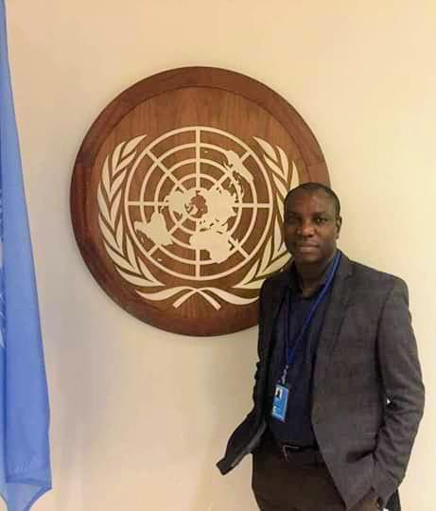
Dr. Chris Kwaja
Senior Lecturer and Researcher at the Centre for Peace and Security Studies, Modibbo Adama University of Technology, Yola, Adamawa State, Nigeria
Previously the Chair-Person Rappertour of the United Nations Working Group on Mercenaries
PhD in International Relations and Strategic Studies,
Research interests in the politics of identity in Africa

Slide 12
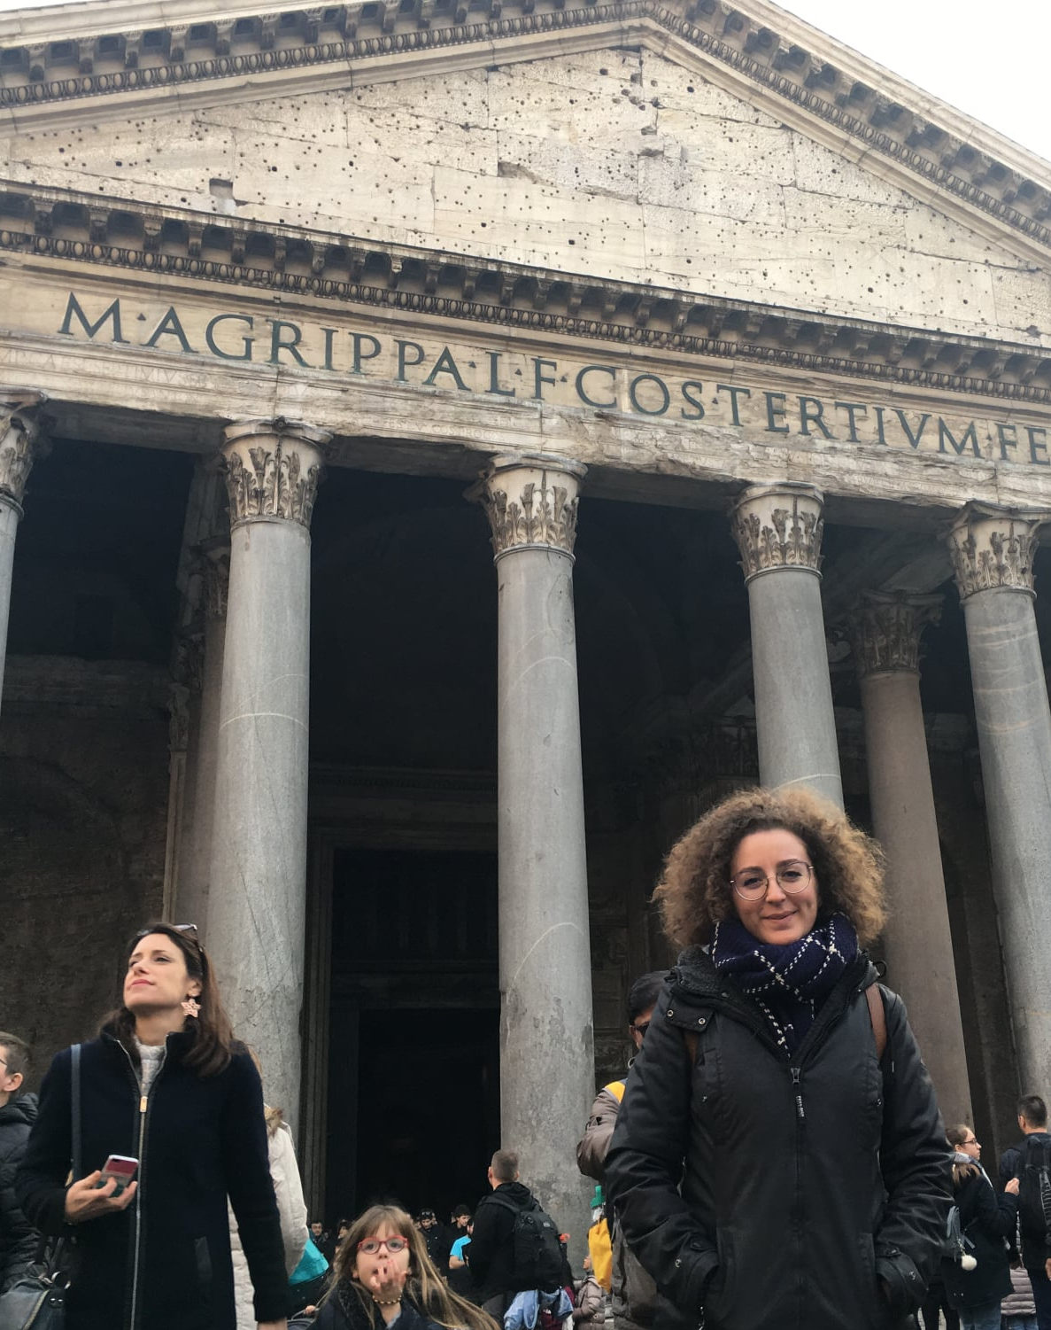
Francesca Falasca, Bachelor of Laws
Currently a graduate student in Conflict Analysis and Dispute Resolution at Salisbury University
Undergraduate degree in Law from the University of Rome Tre, Italy (2016)
Involved in the provision of services as well as teaching, workshop and training events
Currently working as an intern for a movement called Solidarity 2020 and Beyond.
Enjoys communicating and developing positive relationships with people from different backgrounds

Slide 13
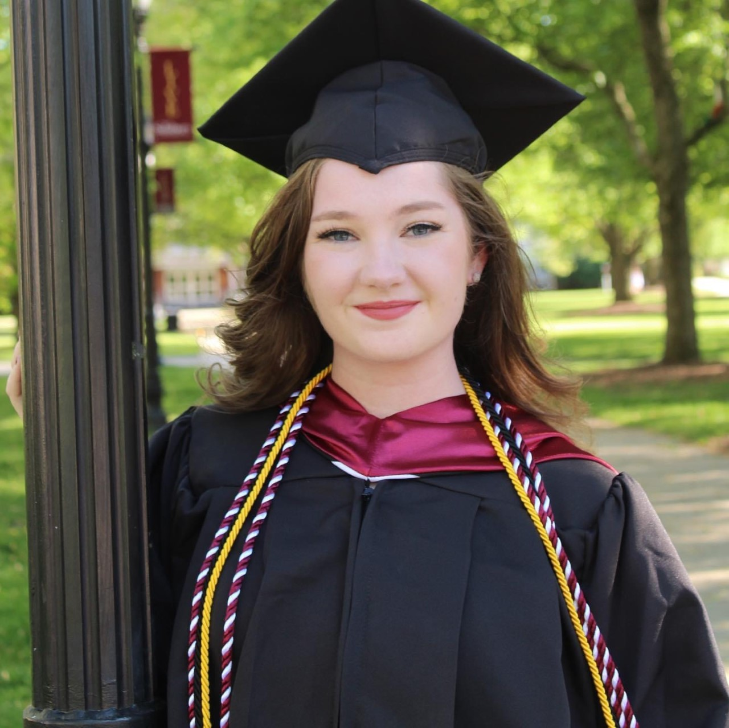
Hannah Prouse, B.A.
Candidate for a M.A. in Conflict Analysis and Dispute Resolution at Salisbury University
Graduated from SU in 2019 with a bachelor’s degree in Conflict Analysis and Dispute Resolution
United Nations Fellow through the United Nations Association- Salisbury University Chapter.

Slide 14
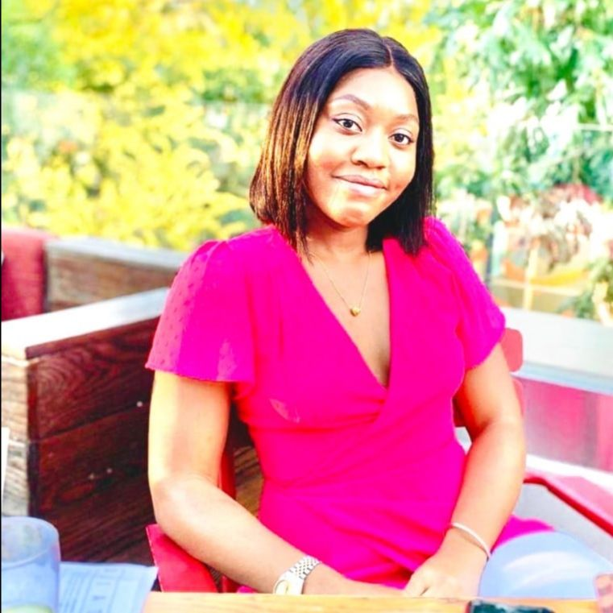
Iye Obge, M.S.
From Nigeria
Graduate from Kennesaw State University’s Conflict Management and Peacebuilding master’s program
Interned at the Cobb County Superior Court in Georgia
Volunteered her time with a non-profit organization (LiveSafe Resources) focused on providing protection for victims of domestic violence, sexual assault, and elder abuse.
Spent a year working for a renowned law firm; Hall Booth Smith
Research interests include human rights and the rule of law, international law, and international relations.
Intends to pursue a postgraduate degree in International relations, specifically, in the areas of international development and international negotiation and conflict resolution.
Intends to change the trajectory of the Nigerian history by spending her time with the United Nations to bring awareness to the sustainability issues in Nigeria

Slide 15
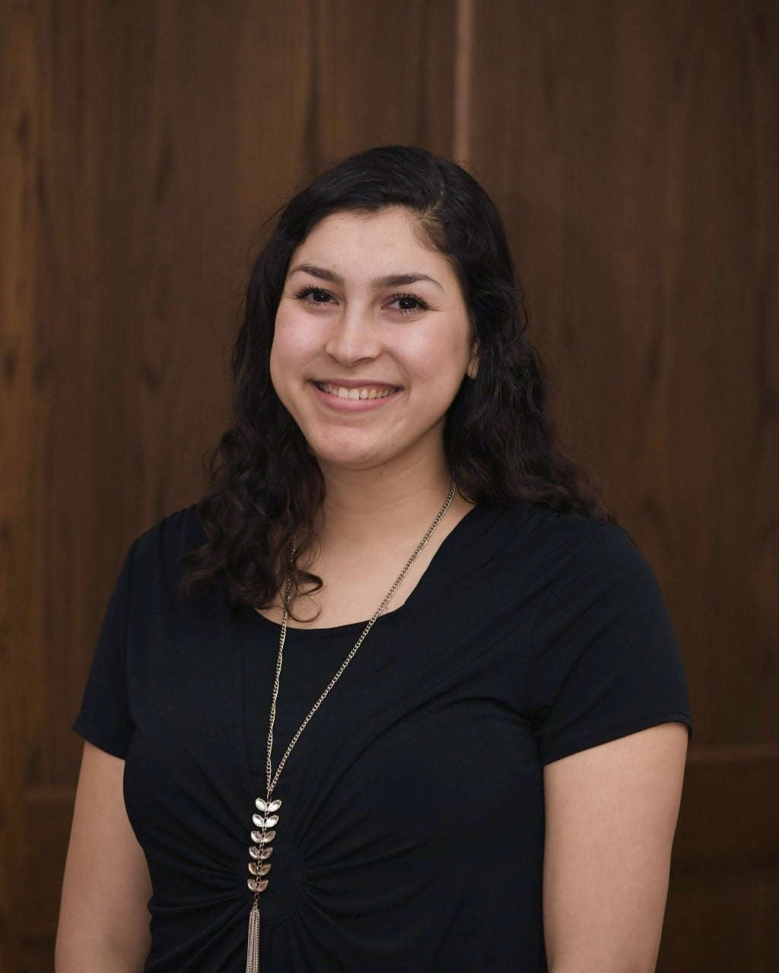
Sandra Zelaya
Undergraduate student at Salisbury University studying Psychology and Conflict Analysis and Dispute Resolution
Interests in social science research and communication
Involved as a student worker, research assistant, and social media contributor for multiple student groups
Participated in the United Nations Millennium Fellowship and hopes to continue social impact work
Enjoys exploring different cultures and is passionate about connecting through music, media, and art.

Slide 16
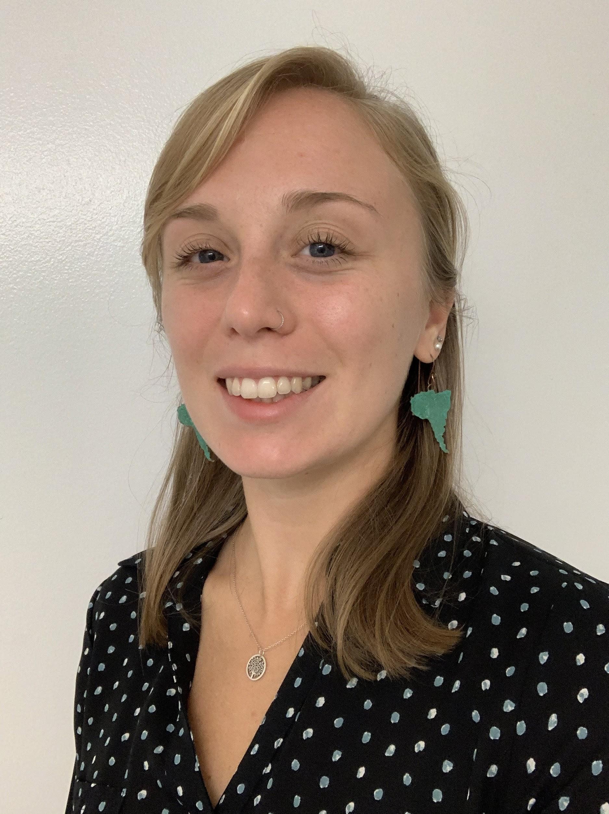
Shannon Rommel, B.A.
Graduated from Salisbury University in 2019.with two Bachelor of Arts, one in Spanish and the other in International Studies
Spent time studying abroad in Spain and teaching English in Chile
Looking to complete a Master’s degree in Latin American Studies at the Universidad Nacional de Cuyo
Working full time at the Center of Help in Annapolis as a Bilingual Case Navigator.
Enjoys her job aiding immigrants in their transition to life in the US and promoting self-sufficiency,
Excited at the prospect of continuing her education in Argentina in 2022.

Slide 17
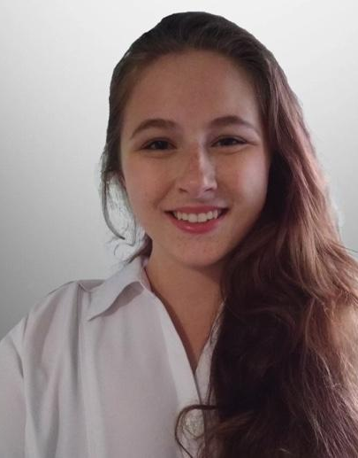
Erin Karrh
Senior at Salisbury University with a CADR major and a Sociology minor
Currently interning under Dr. Brittany Foutz
Operations and Strategy intern at the World Trade Center Institute in Baltimore
Runs a micro-business, focusing on creating and selling art and craft pieces.

Slide 18
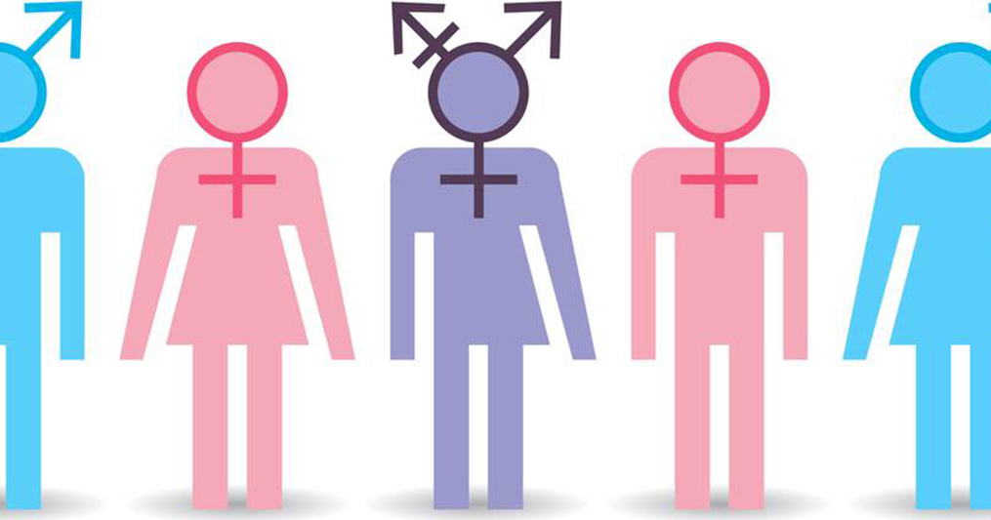
Introduction: Identity
People use a wide variety of words to describe themselves and their identities, and it’s important to respect the terms, names and pronouns people use to refer to themselves.
Today, we will be focusing on gendered identity
Visual from: https://www.praxiscet.com/blog/exploring-gender-identity-what-gender-anyway/.

Slide 19
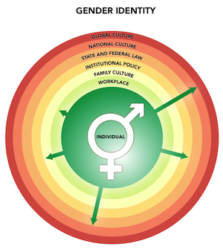
Gendered Identity
Gender identity reflects a deeply felt and experienced sense of one’s own gender. Everyone has a gender identity, which is part of their overall identity.
Explore explanations, examples, and data on gender identities at: https://www.psychologytoday.com/gb/blog/the-mating-game/202006/is-there-gender-hierarchy
The United Nations Free and Equal Campaign Definition of Gendered Identity can be found in full at: https://www.unfe.org/about-2/.
Content and visual from: https://genderedinnovations.stanford.edu/terms/gender.html.

Slide 20
Am I my genes?
-Genetics have many profound implications for personal identity that have not been fully investigated
-Genetics are deeply constitutive of the self
-According to Stuart Hall, identity isn’t inscribed in our genes- one finds themself in an arrangement of social cohesion versus defending oneself against that.
-“It’s not like we have a choice to have a global life. The world is very interconnected.”
- Hall wants us to think about how individuals are using aspects of structure to make life more habitable
Hall, Stuart. "Political belonging in a world of multiple identities." Conceiving cosmopolitanism: Theory, context, and practice (2002): 25-31.

Slide 21
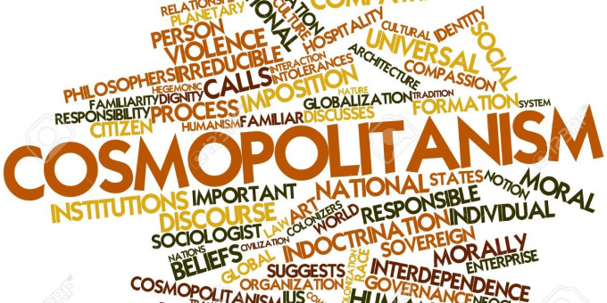
Am I my genes?
-Cosmopolitanism is the belief that all human beings belong to a single community and is based on a shared morality
-Genuine cosmopolitanism is rare
-It came from the Enlightenment
Content from: Hall, Stuart. "Political Belonging in a World of Multiple Identities." Conceiving cosmopolitanism: Theory, Context, and Practice (2002): 25-31.
Visual from: https://www.workersliberty.org/story/2020-03-28/robert-fines-cosmopolitanism.

Slide 22
Discussion:
Why does it feel so awkward when we see someone fail at gender, and why do we care?

Slide 23
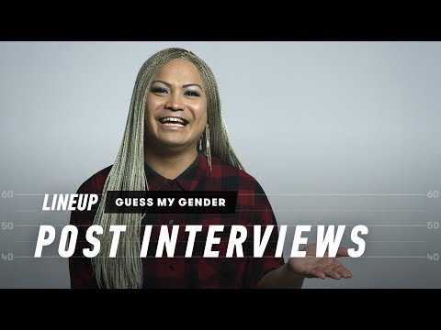
Video from: https://www.youtube.com/watch?v=8_myAQG48cQ.

Slide 24
Gender Terminology
Gender was introduced as a term in the late 1960s as a way to challenge biological determinism, which credits behavioral differences to predisposed biological factors.
“Sex” and “gender” became two distinct terms.
Write down what you think each of these terms means; this could be descriptive words, phrases, actions, etc
Gender. (2018). Gendered Innovations. https://genderedinnovations.stanford.edu/terms/gender.html.
Krieger, N. (2003). Gender, sexes and health: What are the connections -- and why does it matter? International Journal of Epidemiology, 32(6), 652-657.

Slide 25
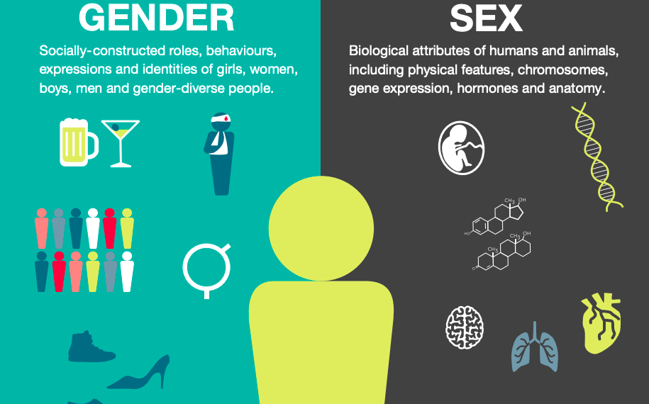
Differentiating Between Gender and Sex
“Sex” refers to a biological construct, while “gender” is regarded as a social construct.
Sex is assigned at birth and refers to biological aspects of a person as determined by anatomy.
Gender refers to behaviors and other elements that are shaped by a society’s understanding of masculinity and femininity.
Content from: Evans, J. & Tolland, L. (2019, February 21). What is the difference between sex and gender? Ons.gov.uk; Office for National Statistics. https://www.ons.gov.uk/economy/environmentalaccounts/articles/whatisthedifferencebetweensexandgender/2019-02-21. Visual from: Image captured from https://cihr-irsc.gc.ca/e/48642.html.
‌

Slide 26
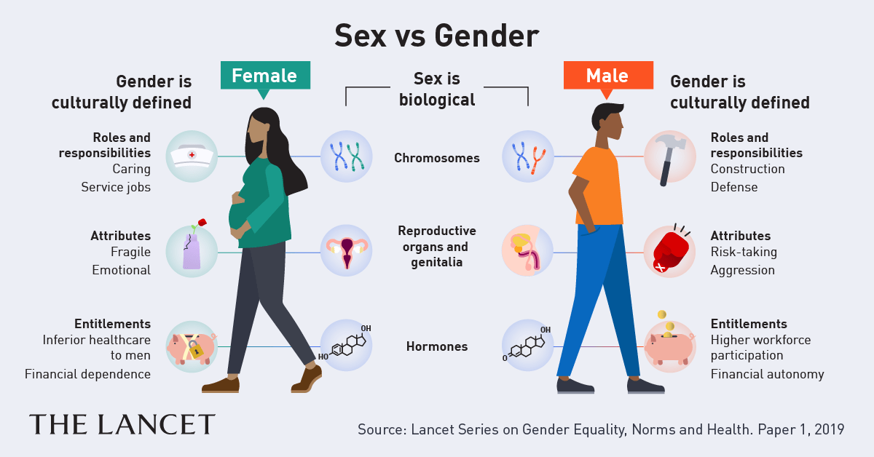
Visual from: https://beyondwordsstudio.com/wp-content/uploads/2019/07/Lancet-social-media-asset-sex-vs-gender.png

Slide 27
Reflection:
Take a moment to think of how you came to learn about gender-
Who influenced and contributed to this learning?
Where did you learn about gender?
How have these encounters shaped your perspective on gender?

Slide 28
The concept and construct of gender has changed through time and across disciplines-
Was one of the first fields to discuss how gender identity is formed
Psychoanalysis
It described a process by which children learn to harness their sex drives to “acceptable channels,”
Sociology
Claimed that gender is socially constructed and children learn it from the adults and social norms around them
We perform a script that includes cues for gender, also referred to as the act “to do” gender
Symbolic Interactionism
Argued that gender is maintained through performance in relation to others
Holmes, Mary. “Gendered Identities” in Elliott, Anthony, ed. Routledge Handbook of Identity Studies. Taylor & Francis, 2012.

Slide 29
The concept and construct of gender has changed through time and across disciplines...
posited that social forces inflict regulation and discipline on the individual, forcing specific performances of how “normal” and/or “healthy” men and women should behave.
Post-structuralism
theory deconstructs ideas of a unified self, and explores how different aspects of identity including gender, race, class; and specifically the experience of these intersecting oppressions, influence the individual’s experience of and understanding of self.
Intersectionality, or standpoint
theories, traditional concepts of gender are challenged. People think about the kind of person they want to be -including gender - and then try to be that person. However, habitual behaviors can end-up reconstructing the traditional social norms and behaviors.
In reflexive modernity
Current work informed by Queer theory
explores gender as fluid.
Holmes, Mary. “Gendered Identities” in Elliott, Anthony, ed. Routledge Handbook of Identity Studies. Taylor & Francis, 2012.

Slide 30
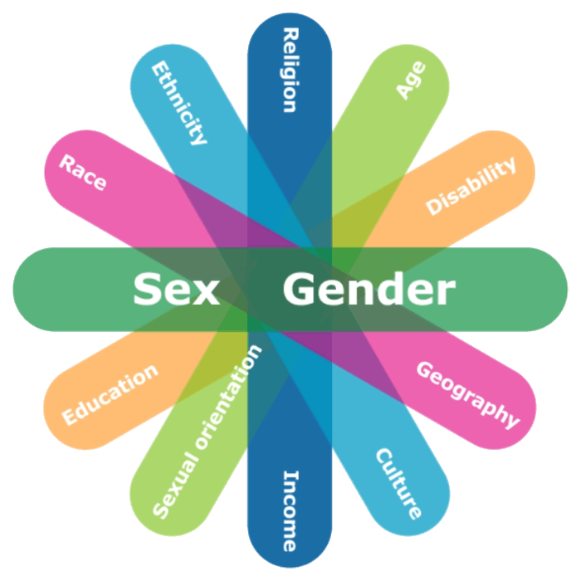
Intersectionality of Identities
-Intersectionality, or standpoint theory, deconstructs ideas of a unified self, and explores how different aspects of identity including gender, race, class; and specifically the experience of these intersecting oppressions influences the individual’s experience of and understanding of self
-Bell Hooks, Angela Davis, Patricia Hill Collins:
Experience of intersecting oppressions of a collective black women’s identity.
Content from: Holmes, Mary. “Gendered Identities” in Elliott, Anthony, ed. Routledge Handbook of Identity Studies. Taylor & Francis, 2012.
Visual from: https://cfc-swc.gc.ca/gba-acs/course-cours/eng/mod02/mod02_03_01a.html.

Slide 31
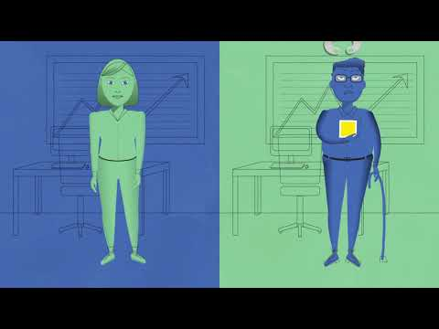
Intersectionality of Identities
-Gendered identities as complex social constructions
-Importance of relation to others in constructing gendered identity
-Critique of Western feminism for propagating an ethnocentric concept of “Third World Women” who are incorrectly presented as a single, coherent group of “eternal victims.”
-Intersectionality is criticized for being essentialist
Content from: Holmes, Mary. “Gendered Identities” in Elliott, Anthony, ed. Routledge Handbook of Identity Studies. Taylor & Francis, 2012.
Video from: https://www.youtube.com/watch?v=O1islM0ytkE&feature=emb_title.

Slide 32
Gendered Identities in Reflexive Modernity
-“Theories of reflexivity try to understand how people form their own self of identity and make their own lives given that traditional ways of doing things have supposedly lost their hold” (193).
-People think about the kind of person they want to be, including gender; and then try to be that person.
-However, habitual behaviors can end-up reconstructing the traditional social norms and behaviors. People are “playing the game” required by politics, law or academia.
-Criticism that it assumes identity is self-consciously created. i.e. people are choosing to play the game
Holmes, Mary. “Gendered Identities” in Elliott, Anthony, ed. Routledge Handbook of Identity Studies. Taylor & Francis, 2012.

Slide 33
Now that we have looked at how the concept and construction of gender has changed through time and across disciplines...
Let’s examine cultural and social influences...

Slide 34
Background: Socio-Cultural Influences on Gender
Both the social and cultural environment influence the construction of gender.
Gender role differences are communicated through culture. This communication, whether verbal or nonverbal, teaches us to behave in accordance with respective gender norms.
Some scholars understand these differences as manifestations of a social contract.
Cultural beliefs can provide rules for a social structure in which gender is starkly differentiated; this differentiation facilitates inequality.
Neculasesei, A.-N. (2015). Culture and gender role differences. Cross-Cultural Management Journal, 17(1), 31-35.
Ridgeway, C. L., & Correll, S. J. (2004). Unpacking the gender system: A theoretical perspective on gender beliefs and social relations. Gender & Society, 18(4), 510–531. https://doi-org.proxy-su.researchport.umd.edu/10.1177/0891243204265269

Slide 35
Cultural Variation of Gender Roles
Gender roles may be more rigidly defined in some cultures, while less so in others.
For example, some indigenous North American cultures understood gender in a more fluid way that differs from the traditional Western binary.
Two Spirit individuals are “Native Americans who were born with masculine and feminine spirits in one body.” Traditionally, they took on distinguished leadership roles, including those of doctors, caretakers, and advisors in conflict resolution.
Indigenous communities today may still uphold values that include Two Spirit traditions. However, those who identify as Two Spirit may face discrimination, arguably influenced by enculturation of Western values that allign with a more rigid gender binary.
Overall, socio-cultural influences on gender roles are dynamic. They can change over time and vary between cultures.
Neculasesei, A.-N. (2015). Culture and gender role differences. Cross-Cultural Management Journal, 17(1), 31-35.
Sheppard, M., & Mayo Jr, J. B. (2013). The social construction of gender and sexuality: Learning from two spirit traditions. The Social Studies, 104(6), 259-270.

Slide 36
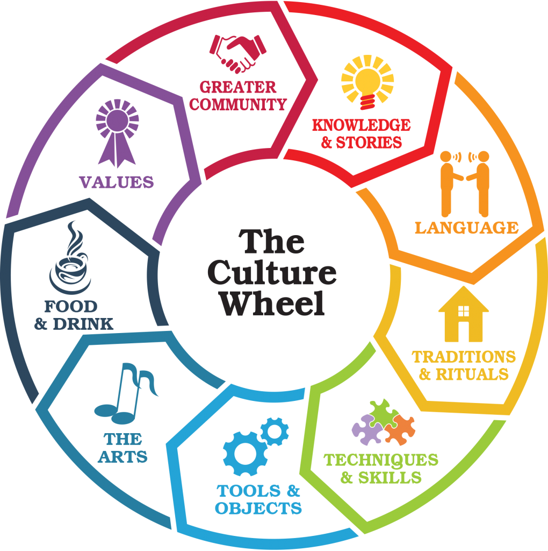
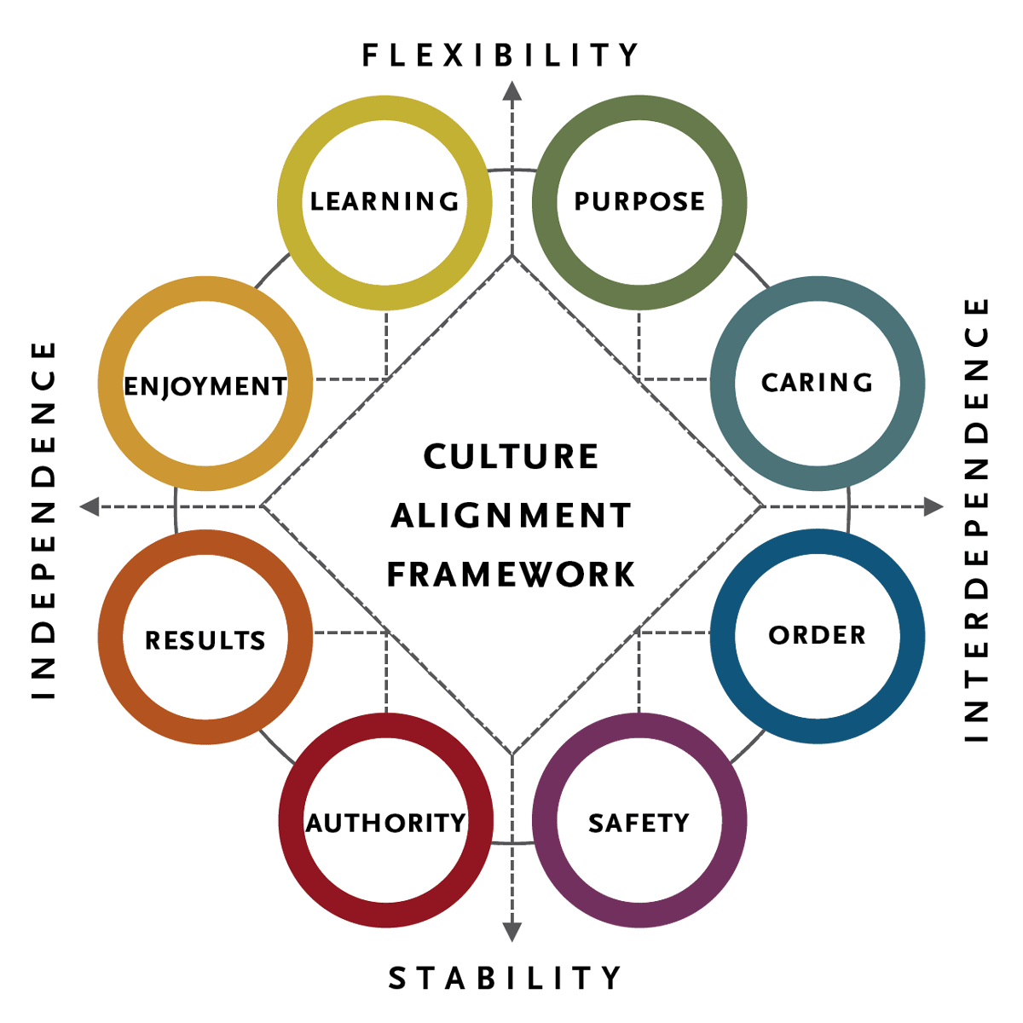
“Culture”
“Culture consists of the derivatives of experience, more or less organized, learned or created by the individuals of a population, including those images or encodements and their interpretation transmitted from past generations, from contemporaries, or formed by individuals themselves.”
Visual from: https://www.spencerstuart.com/what-we-do/our-capabilities/leadership-consulting/organizational-culture
Visual from: https://www.bridgestogether.org/celebrating-our-culture-a-new-how-to-guide/
Content from: Avruch, Kevin. Culture and Conflict Resolution. U.S. Institute of Peace Press, 1998.

Slide 37
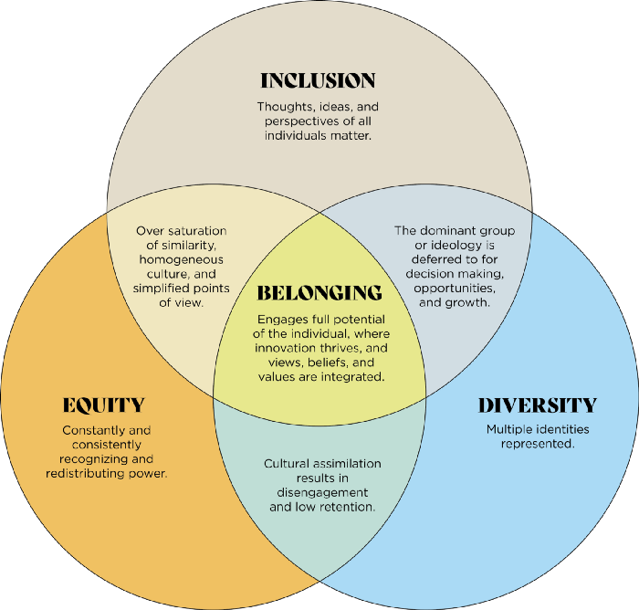
Does power trump culture?
Kevin Avruch: “Power trumps everything, including culture: Where there is a great power over another state, they don’t consider any other elements during this methods of conflict resolution except for power”
Visual from: https://medium.com/@alexmichaelfogleman/the-power-in-cultural-diversity-9a527c74964b.
Content from: Avruch, Kevin. Culture and Conflict Resolution. U.S. Institute of Peace Press, 1998.

Slide 38
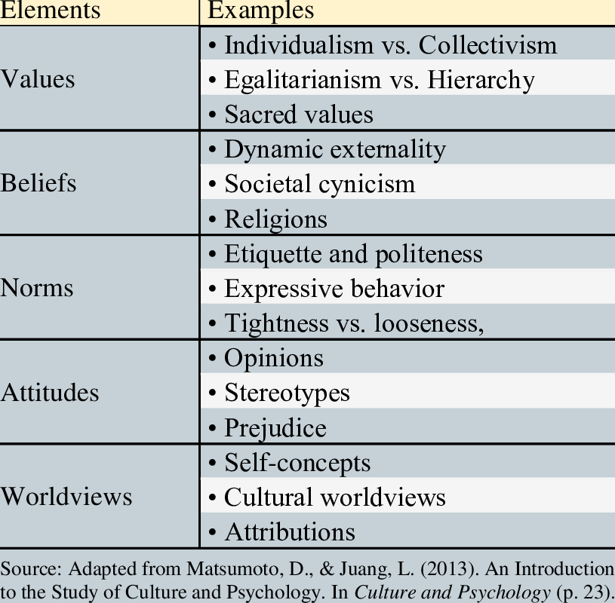
Potential elements of culture
Values: a culture’s standard for discerning what is good and just in society.
Social norms: the standards and expectations for behaving
Formal (Mores): the standards of behavior considered the most important in any society. (Ex. traffic laws, criminal codes, etc)
Informal (Folkways): the standards of behavior that are considered less important but still influence how we behave.
Beliefs: the tenets or convictions that people hold to be true.
Social roles
Status/power
https://open.lib.umn.edu/sociology/chapter/3-2-the-elements-of-culture

Slide 39
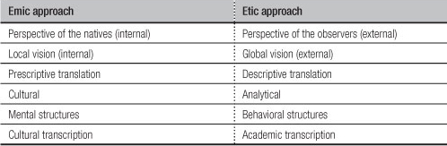
Emic vs Etic Approaches to Studying Culture
-Emic approach: insider perspective
-Etic approach: categorization/descriptors of culture
-Sometimes the line is blurry of the emic and etic approaches.
Visual from: http://ososkova.ru/etics-and-emics-examples/
Content from: Avruch, Kevin. Culture and Conflict Resolution. U.S. Institute of Peace Press, 1998.

Slide 40
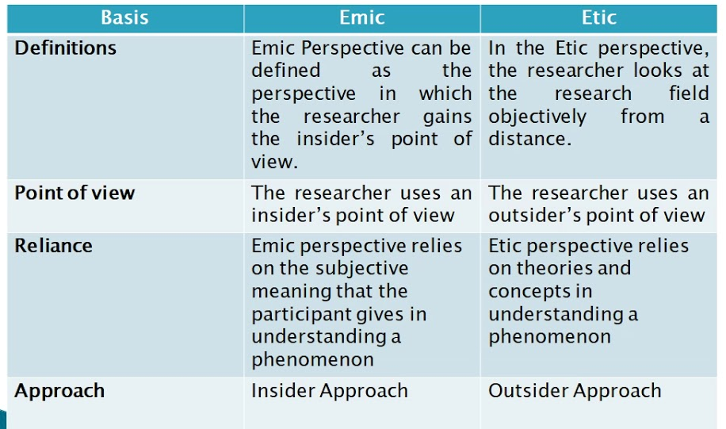
Summary of Emic vs Etic
Visual captured from: https://www.youtube.com/watch?app=desktop&v=sx8aQF7qvVo.

Slide 41
Areas of social influences
Social Influence: the ways in which individuals change their behavior to meet the demands of a social environment.
Explicit Expectations
(clearly and formally stated expectations)
Implicit Expectations
(unspoken rules)
-Conformity: voluntarily change of one’s behavior to imitate the behavior of peers.
-Social roles: expectations from a group about how certain people are supposed to look and behave.
-Compliance: behaving in response to a direct or indirect request.
-Obedience:
behaving in a particular way because someone of higher status has ordered you to do so
https://us.sagepub.com/sites/default/files/07_heinzen_social_influence_0.pdf

Slide 42
Socialization of Gender
Knowledge of gender norms is acquired through socialization, in which people are taught to adhere to societal norms and expectations.
Agents of socialization:
Family: gender roles are often stressed among sons and daughters, whether intentional or not. (e.g. sons can be given more independence than daughters, daughter expected to perform domestic chores such as cooking or cleaning.)
Education: separating groups according to gender, subtle acts of stereotype reinforcement by teachers, different expectations and treatment based on gender.
Peer groups: learning gender expectations from others, marginalization if one does not conform to their gender role.
Mass media: portrayals of male and female characters in several modes of media may reinforce certain stereotypes. (e.g. ingenue, wife, mother, roles with less significance).
Griffiths, H., & Keirns, N. (2015). 12.2 Gender - Introduction to Sociology 2e. OpenStax. https://openstax.org/books/introduction-sociology-2e/pages/12-2-gender

Slide 43
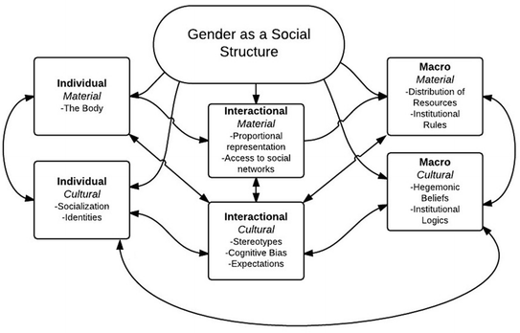
What comprises the Gender social structure?
Risman B.J. (2018) Gender as a Social Structure. In: Risman B., Froyum C., Scarborough W. (eds) Handbook of the Sociology of Gender. Handbooks of Sociology and Social Research. Springer, Cham. https://doi.org/10.1007/978-3-319-76333-0_2.

Slide 44
The Social Construction of Gender
Content from: Holmes, Mary. “Gendered Identities” in Elliott, Anthony, ed. Routledge Handbook of Identity Studies. Taylor & Francis, 2012.
Erving Goffman:
Symbolic interactionism explains self and identity as formed through interaction with others. There is a “script” and people “perform” the script. These scripts claim women are inferior to men, and they are so prevalent that people think this hierarchy is “natural”.
Ann Oakley:
Boys and girls are socialized differently from birth, through family interactions and school.
-Symbolic interactionism, SI, was one of the first areas of sociology to explore gender.
Discover more at : https://www.thoughtco.com/symbolic-interaction-theory-3026633

Slide 45
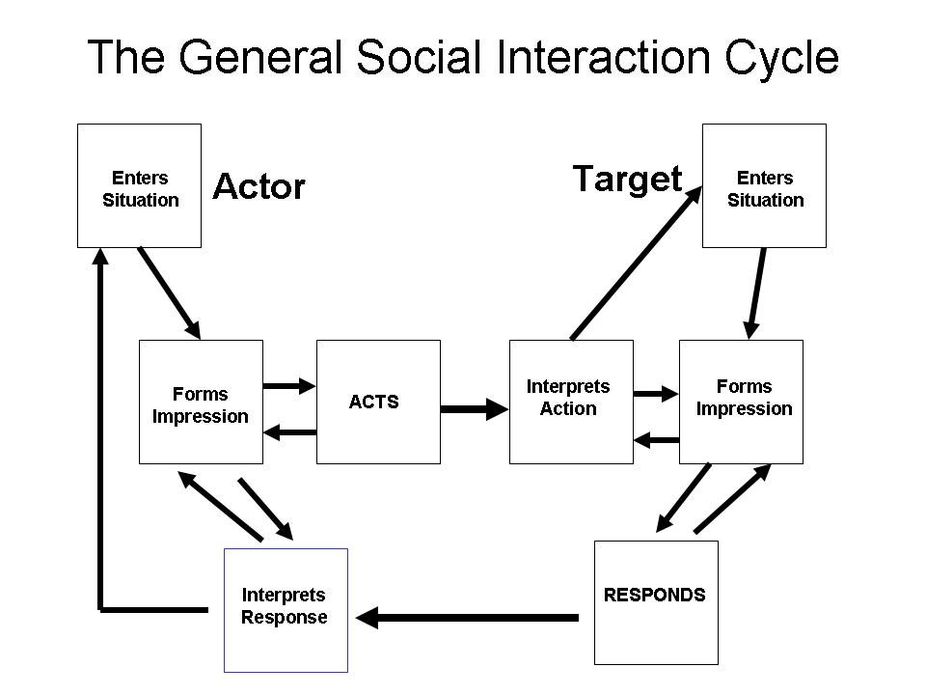
Goffman’s research on social interactions
Social behavior in groups
“Human nature is not nature at all, but it is a ‘ritually organized system of social activity.’”
“Social interaction is all a rehearsed and dramaturgical process of watching and rehearsing.”
Content and visual from: https://lj20buck.wordpress.com/2014/02/13/erving-goffmans-face-work/

Slide 46
The Social Construction of Gender
Candace West and Don Zimmerman claim that we “do gender” differently for different audiences. We must constantly work at it.
“Femininity and masculinity are not derived from bodies or experiences, but a set of made-up ideas about how to act feminine or masculine” (195)
Criticisms include that sociology pays too much attention to early years of life and not how gender is continually constructed throughout life.
Also implied is that people can choose how to do their gender, which is not always the case. People may not be aware of the scripts they internalized, or they may not be able to choose certain expressions.
Holmes, Mary. “Gendered Identities” in Elliott, Anthony, ed. Routledge Handbook of Identity Studies. Taylor & Francis, 2012.

Slide 47
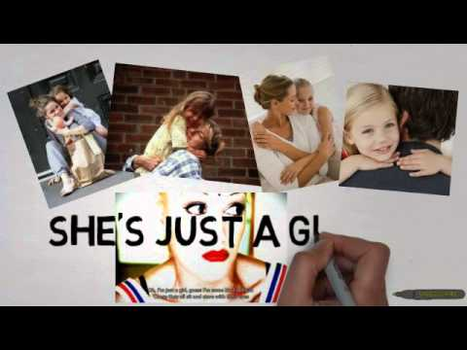
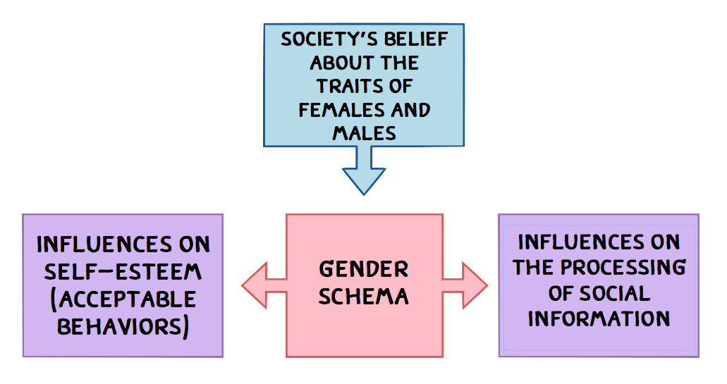
We recognize that there are other influences, such as:
Psychological explanations of gender development
Cognitive developmental theory - Kohlberg
Gender schema theory
Find out more here!
Visual from: https://letsgetpsyched.wordpress.com/2013/12/15/how-are-gender-roles-developed/
Movie from: https://www.youtube.com/watch?v=scZ_Ys4AY2g

Slide 48
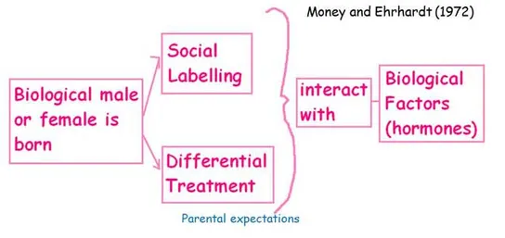
Continued influences-
Biological influences on gender:
Role of hormones and genes in gender development
Evolutionary explanations of gender
Biosocial approach to gender development
Visual from: https://www.simplypsychology.org/gender-biology.html#:~:text=The%20evolutionary%20approach%20argues%20that,ancestors%20to%20survive%20and%20reproduce.

Slide 49
Media, Gender, and Conflict Resolution Skills
Abstract from- Civilizing Prime Time: Gender and Conflict Resolution in the 2004-05 Season
“Using a sample of 129 situation comedies, dramas, and reality programs airing during the 2004–05 prime-time season on the broadcast networks, this study examined the relationship between the gender of storytellers and on-screen portrayals of conflict resolution. The study found that the employment of at least one woman storyteller was related to the more equitable use of conflict resolution strategies and more ‘‘civilized’’ conflict resolution strategies among characters.”
Lauzen, M., & Dozier, D. (2008). Civilizing Prime Time: Gender and Conflict Resolution in the 2004-05 Season. Mass Communication & Society, 11(3), 300–318. https://doi-org.proxy-su.researchport.umd.edu/10.1080/15205430701668097

Slide 50
Media, Gender, and Conflict Resolution Skills Cont’d.
Female characters were more traditional in their occupations and less violent in their methods of conflict resolution.
Female authors tended to avoid conflicts in their stories or to use nonviolent means of resolving conflicts.
Male authors were more likely to use violent conflict resolutions.
In addition, leading characters in the children's stories tended to be the same sex as the author, although girls were more likely to write about male protagonists than were boys to write about female protagonists.”
Lauzen, M., & Dozier, D. (2008). Civilizing Prime Time: Gender and Conflict Resolution in the 2004-05 Season. Mass Communication & Society, 11(3), 300–318. https://doi-org.proxy-su.researchport.umd.edu/10.1080/15205430701668097

Slide 51
Media, Gender, and Conflict Resolution Skills Cont’d.
- Finally, more boys than girls seem tied to violent strategies for ending conflict.
- Opponents are often physically restrained or eliminated in the fantasy stories written by boys.
- Girls are more varied in the resolution strategies employed in their fantasy stories.
- These included reasoning, analysis, trickery, and avoidance.
- This finding is consistent with that of Block (1978), and with the literature regarding children's play,
which found that boys were active while girls were passive. In addition, girls were more likely to place a value judgment on the way the characters in their stories behaved.”
Lauzen, M., & Dozier, D. (2008). Civilizing Prime Time: Gender and Conflict Resolution in the 2004-05 Season. Mass Communication & Society, 11(3), 300–318. https://doi-org.proxy-su.researchport.umd.edu/10.1080/15205430701668097

Slide 52
Take a moment to reflect on you experiences and world perceptions...
Do you think that women are often automatically placed into a role as a mother, sister, daughter, caregiver?
Are women typically assumed to take on a pre-assigned role?
How can we break the cycle of giving gender-based roles?

Slide 53
Performing Gender-
D+ Improv women set out to break the gender stereotype
(https://timesdelphic.com/2016/09/d-improv-women-set-out-to-break-the-gender-stereotype/)
“It’s not about the gender of the person, but about the person themselves and how they present themselves”
“A man can go on stage and be himself, but as a woman I feel that I have to be bigger, lower my voice or be more masculine.
“As a woman you have to prove yourself more,”
“It’s not about the gender of the person, but about the person themselves and how they present themselves through the jokes they tell”
“A lot of the women who are kind of shoved under the rug are those who are more physical and do more masculine things.”
“It’s easy to give someone a character, but it’s even easier to give them a gender role, and often enough it’s a woman being put into that box,”

Slide 54
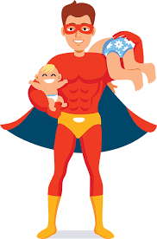
“Superdads” and reversed gender roles discussion
Dads taking on responsibility of caregiver, etc. v. moms already doing the work
Dad being referred to as a superdad in roles where the women are already doing the work. Why not supermoms?
Image from: https://www.facebook.com/Epicwinbydad
Notes:
When we use the phrase “taking time away from our children," even when this time away is work---which, as you so beautifully articulate, is a mental health and creative necessity for many mothers. Yet I do not usually hear fathers say they are taking time away from their kids; absences are couched more in terms of duty, or doing it for the kids, or having a noble job, etc. I wonder if those of us who use this language of taking away could act less like our normal lives are a sabbatical to justify, and more like just what we do. You are a professor, you are a mother; we go to work, we come back home. Just as our kids are not taking time away from us when they are bettering themselves at school, or extracurricular activities, we are not taking time away from them by doing what we do. While time is a limited resource, and our children grow so quickly, much attention and care can be packed into small moments so as to make them seem eternal---listening to a song together, picking a flower, blowing dandelions. I might be "down for the count" for hours or *gasp* occasionally reading for pleasure, but this is no different from my kids playing and reading to themselves. Then we all come back together the better for it, bringing our whole selves into small together moments.

Slide 55
What is the hierarchy to determine the gender norms?
Gender is not simply a set of ideas about male and female people and their relations to each other
Gender can be seen as a way of categorizing, ordering, and symbolizing to create power imbalances:
-hierarchically structuring relationships among different categories of people
-different human activities symbolically associated with masculinity or femininity (3)
For further information, explore:
https://literariness.org/2017/11/02/gender-order/

Slide 56
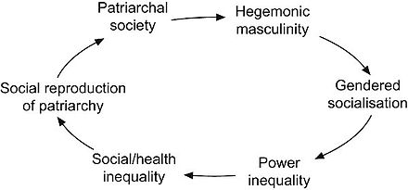
What is the hierarchy to determine the gender norms?
-Gender differences are integral to the culture of domination (3)
-Masculinity is constructed as powerful, aggressive, controlling (3)
-Femininity as inferior, weak, submissive, serving or more positively nurturing (3)
Visual from: https://www.wikiwand.com/en/Hegemonic_masculinity

Slide 57
Cultural Framing of Western Values and the Women as “Needing Saving”
This assumes the superiority of certain Western values and ignores the complex social and historical events and political decisions that created the power systems we see today.
There is a space for respecting difference that does not dissolve into cultural relativism, and challenges anthropology, feminism, and other disciplines to focus on social justice instead of obsessing about veils.
“Women are not special beings that need to be shielded. Protecting women, especially in a patronizing and infantilizing way, distracts us from recognizing that women are human beings deserving of respect just like everyone else”
Content from: https://www.rappler.com/voices/ispeak/opinion-women-more-than-victims-needing-personal-protection

Slide 58
Cultural Framing of Western Values and the Women as “Needing Saving”
Cooperation more than Protection - Women do not need protection per se, but cooperation to smash the system that has forced them into a box labeled “vulnerable”. Demanding justice and making perpetrators of sexual violence accountable need collective efforts. For this reason, allies are needed more than defenders.
President of the Philippines, Rodrigo Roa Duterte, called his daughter a drama queen for coming out as a rape survivor -
Investigate the news article here: https://newsinfo.inquirer.net/780443/duterte-calls-daughter-drama-queen
Women are more than victims needing personal protection. They are victimized human beings needing cooperation to change the system that makes them vulnerable and lets their abusers off the hook.
Content from: https://www.rappler.com/voices/ispeak/opinion-women-more-than-victims-needing-personal-protection

Slide 59
Sexism involved with Western Stereotypes
-“Hostile sexism” is a term that refers to stereotypes against women that do not follow the traditional role of the woman (i.e: women with a career, lesbians, feminists, etc.)
-This type of sexism views these women as competent, yet cold
-It openly criticizes and belittles women
-“Benevolent sexism” refers to the affection granted to women who comply with the traditional role of the woman (i.e: housewives, cheerleaders, secretaries, etc.),
-This type of sexism views these women as incompotent, yet warm
-It undermines women’s autonomy and accomplishments
- Hostile sexism and benevolent sexism work together to reinforce male dominance and male-female interdependence
Fiske, Susan T. “Prejudices in Cultural Contexts: Shared Stereotypes (Gender, Age) versus Variable Stereotypes (Race, Ethnicity, Religion).” US
National Library of Medicine National Institutes of Health, Sept. 12, 2017. https://www.ncbi.nlm.nih.gov/pmc/articles/PMC5657003/.

Slide 60
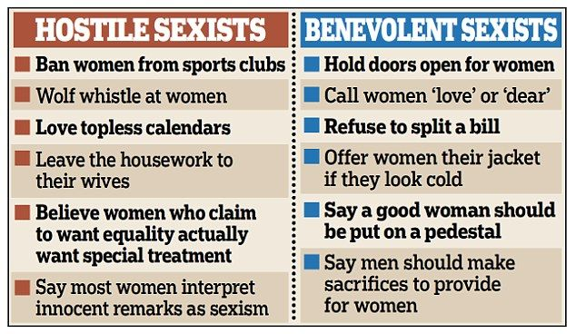
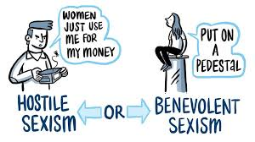
Hostile vs Benevolent Sexism
Learn more about sexism in disguise here: https://www.dailymail.co.uk/sciencetech/article-2988310/How-smile-reveals-man-s-SEXIST-Beliefs-women-betrayed-facial-expressions-claims-study.html#ixzz3UBxikGAB
https://www.dailymail.co.uk/sciencetech/article-2988310/How-smile-reveals-man-s-SEXIST-Beliefs-women-betrayed-facial-expressions-claims-study.html#ixzz3UBxikGAB
https://www.facebook.com/thrivewithmentoring/posts/benevolent-sexismbenevolent-sexism-represents-evaluations-of-gender-that-may-app/248312242544168/

Slide 61
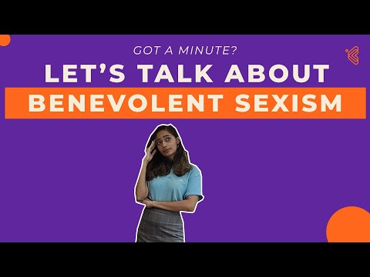
Gender Stereotypes & Sexism
Learn more about ambivalent and benevolent sexism here:
Hostile and benevolent sexism both function to reduce female autonomy and reinforce male dominance
Due to the prevalence of these stereotypes, men are the considered to be the “dominant group”
Across cultures, men consistently scored higher for both hostile and benevolent sexism
Even though women exhibit patterns of hostile and benevolent sexism towards other women, their prejudice does not have the same power that it does coming from a man
Studies suggest that the dynamic between men and women could change as economic development provides both sexes with job opportunities and male dominance decreases
Video from: https://www.youtube.com/watch?v=_7KHm4A5Lbo
Content from: Fiske, Susan T. “Prejudices in Cultural Contexts: Shared Stereotypes (Gender, Age) versus Variable Stereotypes (Race, Ethnicity, Religion).” US
National Library of Medicine National Institutes of Health, Sept. 12, 2017. https://www.ncbi.nlm.nih.gov/pmc/articles/PMC5657003/.

Slide 62
Stereotypes across cultures
accommodating
thin and graceful
Dressed and makeup
emotional
Cook and clean
Gender stereotypes exist across cultures, but with varying intensity
Hostile and benevolent sexism exist throughout the world, making it difficult for people to break through these gender stereotypes without encountering animosity
In general, the following is true: “Women and older people who comply with prescriptive stereotypes are cherished as warm but incompetent; those who resist are resented as competent but cold.” (Fiske, 2017)
See more examples of gender stereotypes and their impact here: https://www.genderequalitylaw.org/examples-of-gender-stereotypes
Fiske, Susan T. “Prejudices in Cultural Contexts: Shared Stereotypes (Gender, Age) versus Variable Stereotypes (Race, Ethnicity, Religion).” US
National Library of Medicine National Institutes of Health, Sept. 12, 2017. https://www.ncbi.nlm.nih.gov/pmc/articles/PMC5657003/.
Play with dolls
Wear pink
Well behaved

Slide 63
Gender, Communication Styles, and the Hierarchy
Deborah Tannen’s You Just Don’t Understand: Women and Men in Conversation concludes that there is a significant gender difference in communication styles in United States English speakers.
Men are more likely to employ conversation to exchange information and establish hierarchy, whereas women employ conversation to establish emotional connection.
This difference occurs from an early age.
Tannen refers to the “message”, which is the actual content of a communication, and the “metamessage, which is its unspoken implications.
Women tend to be more tuned into the metamessage, men to the message (192).

Slide 64
Reflexive Identities
Refugees struggle with their identity when moving to a different culture.
When you move so much what is the structure in which you identify with?
How do we think about structure when trying to understand the identity of a person?

Slide 65
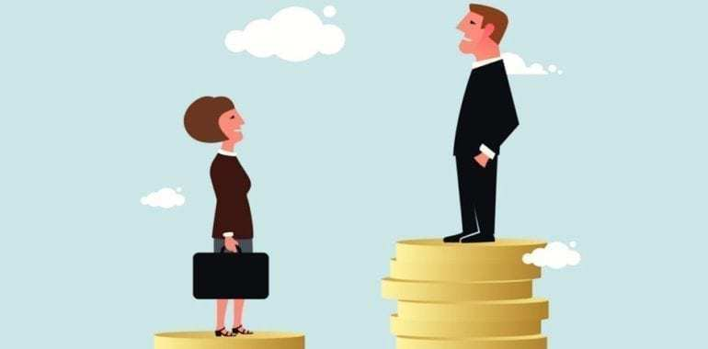
Gender and virtual identity
How does technology impact our construction of gender?
Does virtual reality dissolves the distinctions, the separations, and the connections that characterize so much of the physical world and our social constructions of it?
Are our identities portable to online? What is our meaning and identity in cyberspace?
Visual from: https://openexpoeurope.com/how-technology-can-reduce-gender-inequality/

Slide 66
United Nations and Gender - A Timeline
1945 - the Commission on the Status of Women was created within the UN’s first year (important achievement: ensured gender neutral language in the draft Universal Declaration of Human Rights)
1979 - the adoption of the Convention on the Elimination of All Forms of Discrimination against Women (CEDAW)
1980 - Second World Conference on Women held in Copenhagen
1985 - the World Conference to Review and Appraise the Achievements of the United Nations Decade for Women: Equality, Development and Peace, was held in Nairobi (gained true recognition)
1995 - Fourth World Conference on Women, held in Beijing (important achievement: The Beijing Platform for Action asserted women’s rights as human rights)
2000 The UN’s formal women, peace, and security (WPS) agenda was institutionalized in 2000 with the adoption of UN Security Council Resolution 1325, which calls for gender considerations to be placed at the center of all aspects of the UN’s work
2010 - The creation of the UN Entity for Gender Equality and the Empowerment of Women – or UN Women – included four agencies/ offices: the UN Development Fund for Women (UNIFEM), the UN International Research and Training Institute for the Advancement of Women, the Office of the Special Adviser on Gender Issues, and the Division for the Advancement of Women (DAW).
https://www.un.org/en/sections/issues-depth/gender-equality/

Slide 67

UN Women
UN Women is located all around the world and has a number of initiatives that aim to help women acquire their full potential and achieve gender equality
Leadership and political participation - the UN is working to break down structural barriers so that women can participate as voters, leaders, and more
Economic empowerment - the UN invests in women’s economic empowerment and the eradication of poverty
Ending violence against women - the UN aims to prevent and respond to gender violence
Peace and security - the UN calls for women to help prevent war and keep the peace
Content and logo from: https://www.unwomen.org/en/what-we-do

Slide 68
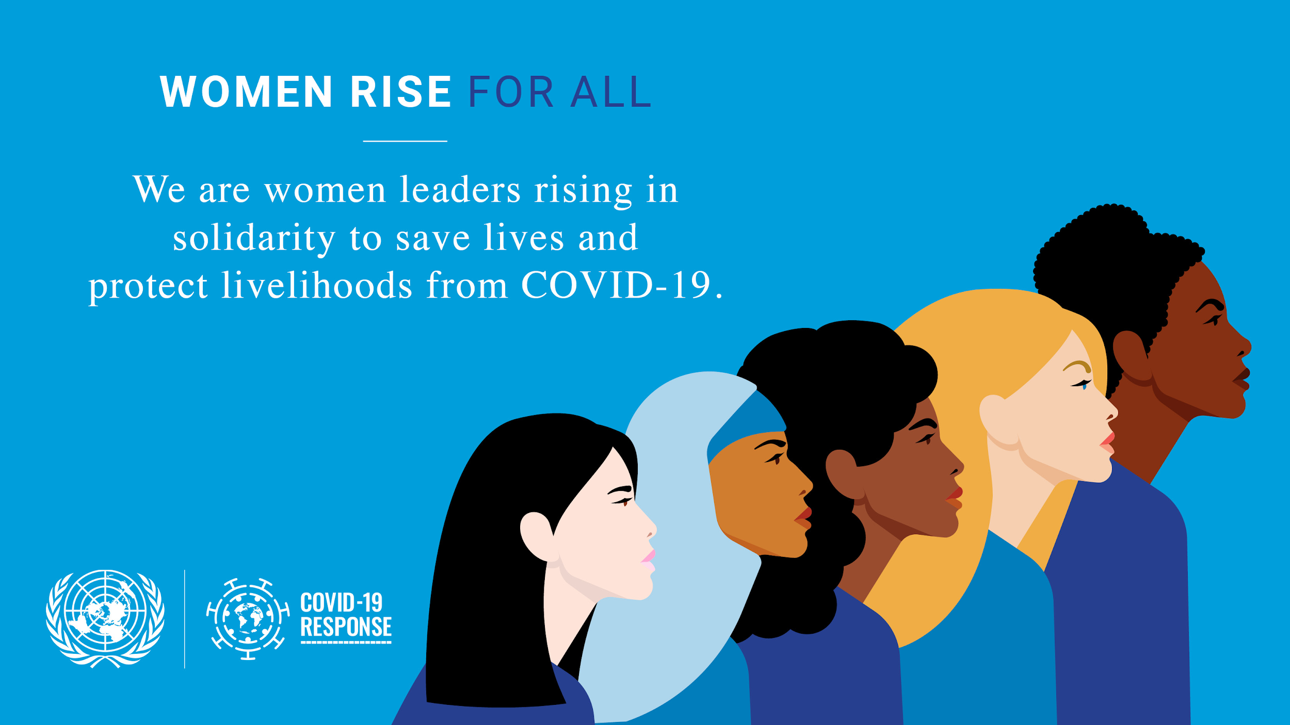
UN Women (cont.)
Humanitarian action - aims for the inclusion of women during the preparation and response of humanitarian crises
Youth - focuses on equal access to education, leadership, and other opportunities
Women and girls with disabilities - the UN aims to fully include women/girls with disabilities in society
Governance and national planning - identifying and changing gender gaps within a government
Sustainable development agenda - aims to achieve human rights for all, including the empowerment of women and girls
HIV and AIDS - empowering women to protect themselves from infection, fight the stigma, and have access to treatment
Visual from: https://www.un.org/en/coronavirus/women-rise-for-all
Content from: https://www.unwomen.org/en/what-we-do

Slide 69
Sustainable Development Goal #5 & COVID
2016 - The UN launched 17 Sustainable Development Goals (SDGs) as part of the 2030 Agenda for Sustainable Development
SDGs are call to actions to all that aim to “promote prosperity while protecting the planet”
Goal 5: Achieve gender equality and empower all women and girls
This goal has become especially important for the COVID-19 response, as women have been the hardest hit by the pandemic
Every UN COVID response plan must:
Include women & women’s organizations in the planning and decision-making regarding the COVID-19 response
Transform unpaid care work into a care economy
Design socio-economic plans that intentionally focus on the lives & futures of women/ girls.
https://www.un.org/sustainabledevelopment/gender-equality/

Slide 70
UNSC 1325 Resolution
“Reaffirms the important role of women in the prevention and resolution of conflicts, peace negotiations, peace-building, peacekeeping, humanitarian response and in post-conflict reconstruction and stresses the importance of their equal participation and full involvement in all efforts for the maintenance and promotion of peace and security”
Resolution 1325 urges all actors to increase the participation of women and incorporate gender perspectives in all United Nations peace and security efforts.
Covers:
human rights violations
gender-specific humanitarian concerns
prevention of conflict
protection and assistance during conflict
accountability for crimes committed during war
conflict prevention
conflict resolution
post-conflict reconstruction
Discover more at: https://www.peacewomen.org/SCR-1325
https://www.un.org/womenwatch/osagi/wps/

Slide 71
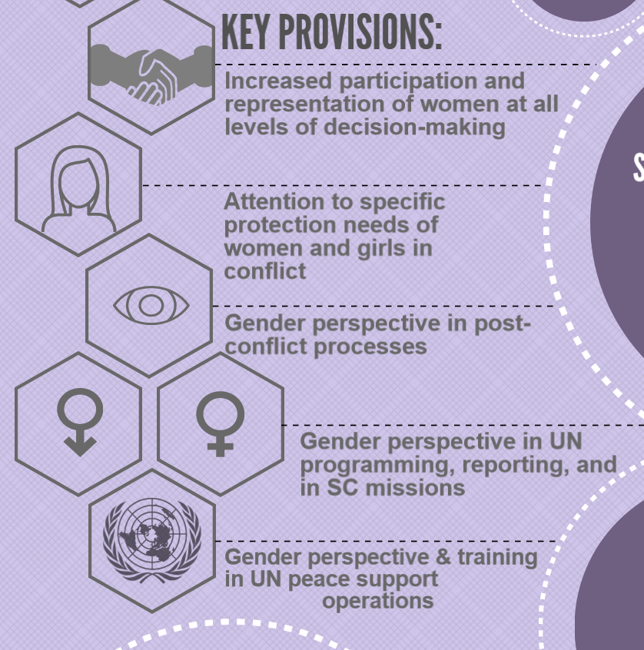
UNSC 1325 Resolution
Also covers:
- Recognition of a complex understanding of
gender
- Including constructions of femininity and
masculinity
- Support for LGBTQ communities targeted in
conflict
- Specific needs of women with disabilities and
of women widowed by conflict
- Intersectional dynamics of race, ethnicity, and
gender in armed conflict
Content and visual from: https://www.un.org/womenwatch/osagi/wps/

Slide 72
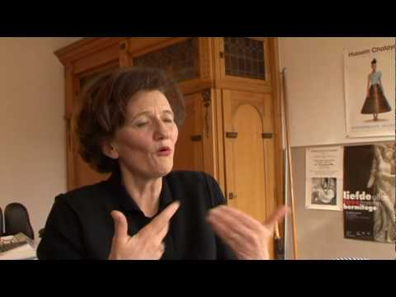
Understanding Gendered Identities Continues to be Important: Future Developments
Rosi Braidotti argues to rejoin sex and gender to understand better the symbolic systems at work between images and ideas. She also sees gender as an “ongoing process of becoming.”
“Identities continue to be formed especially around major sites of inequality: gender, class, ethnicity, sexuality, age, and disability” (199)
Further materials: a documentary featuring Rosi Braidotti
Content from: Holmes, Mary. “Gendered Identities” in Elliott, Anthony, ed. Routledge Handbook of Identity Studies. Taylor & Francis, 2012.
Video from: https://www.youtube.com/watch?v=82h6gI0EJ_8&feature=emb_logo

Slide 73
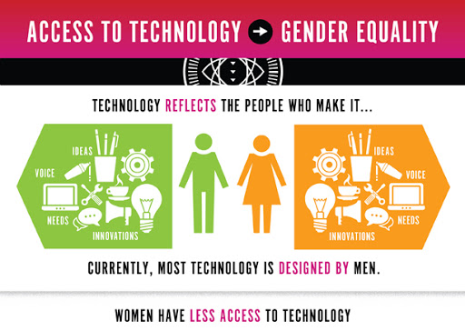
Understanding Gendered Identities Continues to be Important: Future Developments
*Anthony Giddens writes that in choosing identity, individuals can now choose sex, though this option is not equally accessible to all
*Donna Haraway discusses the use of technology, and that we are all part human –nature- and part machine culture- things like hip replacements
*Virtual spaces are areas where people can take on new genders, those the overall constructs and concepts of gender are pretty conventional
Find out more about gender inequality in accessing technology here: http://ignite.globalfundforwomen.org/gallery/infographic-how-does-access-technology-lead-gender-equality (visual can be found here)
Content from: Holmes, Mary. “Gendered Identities” in Elliott, Anthony, ed. Routledge Handbook of Identity Studies. Taylor & Francis, 2012.

Slide 74
How our field can help
Facilitation and use of interactive tools is create safe spaces that provide disruption, enabling people to think about things differently and critically reflect on how gender beliefs and practices are operating in their lives
But our gender mistakes have the potential for something good.
Even in the binary, approaching life on the stage as a man or a woman, we can support each other in experimentation, and our trips and stumbles.
Further reading: creating gender safe spaces
https://www.manilatimes.net/2018/11/08/campus-press/creating-safe-spaces-for-all-genders/463772/

Slide 75
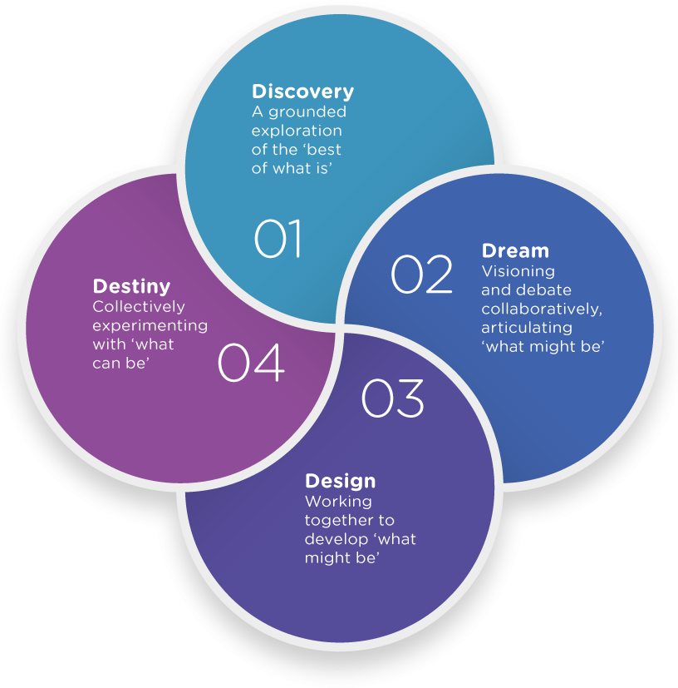
Appreciative Inquiry and Gender: What is Appreciative Inquiry?
Appreciative Inquiry(AI) is a research method that uses the “heliotropic principle” to redesign organizational structures. The AI method theorizes that people, like plants, grow towards their light source, or what gives them hope for the future. AI follows the “4D Model”: Discovery, Dreaming, Designing, Destiny. This model seeks to resolve organizational conflict through a positive lens-focus on what strengths the organization has to identify its weakness. AI also provides a safe arena for negative experiences to be shared and discussed.
Content from: Michael, Sarah. “Oxfam GB the Promise of Appreciative Inquiry as an Interview Tool For.” Source: Development in Practice, vol. 15, no. 2, 2005, pp. 222–30, doi:10.1080/096.
“Fig.1 – the 4D Cycle.” Forming New Futures through Appreciative Inquiry, 2016, www.iriss.org.uk/sites/default/files/styles/max_1300x1300/public/4d-diagram-2.png?itok=NOlqGR62.

Slide 76

Everyday Examples of Appreciative Inquiry
Appreciative inquiry works by identifying the good to determine what is working and which direction to head. Think about it like training a pet:
Discover: What does my pet already know? What do they like? What makes them happy? How do they make me happy?
Dream: What are my training goals for my pet? Will it benefit our relationship? Why do I want to train my pet in this certain way?
Designing: What is the best way to train my pet? What motivates them? How can I use their strengths to reach my training goals?
Destiny: What training methods have been working? Where else can we go from here?
“Girl Training Husky Puppy.” Figo Pet Insurance, 2017, figopetinsurance.com/blog/5-basic-puppy-commands.

Slide 77
Using Appreciative Inquiry in Conflict Resolution
What place does AI have in the field of conflict resolution? As a research tool, AI provides an interview framework to gather valuable qualitative data on the positive core, or strengths, of individuals and organizations. This allows researchers to understand the base their working with to create change. As a restructuring tool, AI empowers individuals and organizations to leverage their strengths to create positive changes or resolutions.
Content from:Armstrong, Amy J., et al. “A Changing World, Again. How Appreciative Inquiry Can Guide Our Growth.” Social Sciences & Humanities Open, vol. 2, no. 1, 2020, p. 100038, doi:10.1016/j.ssaho.2020.100038.

Slide 78
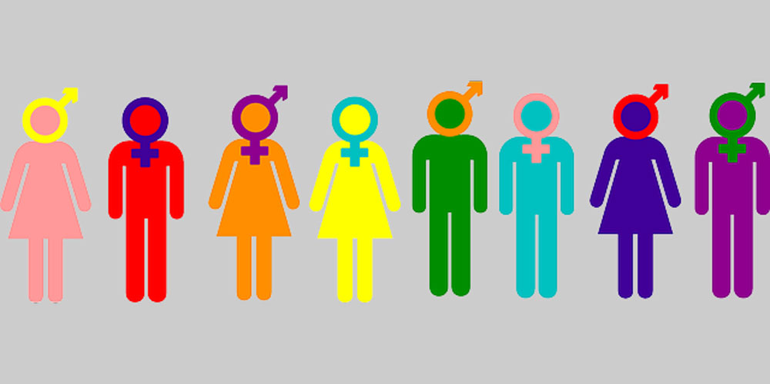
Appreciative Inquiry and Gender
How can we use appreciative inquiry to understand gender and resolve gender based issues? How can it contribute to the previous conversations of gender vs sex, gender stereotypes, sexism, social constructs of gender, etc? When would we use AI to solve gender based issues/conflicts?
“All Genders.” Denison University, 2018, denison.edu/campus/gender-sexuality/wh/127379.

Slide 79
Appreciative Inquiry and Gender: Scenario 1
DJ’s workplace has an issue with gender based harassment. DJ feels discriminated against based on their gender identity, and they feel that harmful stereotypes surround them at work. DJ loves their job but doesn’t feel safe at work. They know they are not the only person who feels this way, and many of their coworkers experience harassment as well. They are trying to set up a committee to resolve the issue, but coordinating everyone’s ideas is difficult. How can appreciative inquiry help create positive change in this workplace?
Remember the 4D model!

Slide 80
Example 4D model:
Define: the best of what is
Dream: design what might be
Design:create what might be
Destiny: what can be
How would you use appreciative inquiry in this scenario?
Define: DJ likes their job and has taken initiative to change their situation
Scenario 1
Destiny: DJ and their coworkers will keep innovating and developing solutions to address harassment in their workplace
Dream: DJ and their coworkers want a safer, more accepting workplace. They all are collaborating to achieve this goal
Design: DJ and their coworkers will work together to create a committee to address the harassment issues and create a safe and accepting workspace

Slide 81
Appreciative Inquiry and Gender: Scenario 2
The women of the country Fakecountria are frustrated by the lack of economic and educational opportunities for them. Few women are gainfully employed, fewer women occupy political office, and many young girls are forced to leave school at an early age to fill caregiver roles. There are several non-profits working in the region to achieve gender equality and to empower women, but little progress is being made. How can appreciative inquiry be used to meet UN Sustainability Goal #5 in this country (achieve gender equality and empower all women and girls)?

Slide 82
Example 4D model:
Define: the best of what is
Dream: design what might be
Design:create what might be
Destiny: what can be
How would you use appreciative inquiry in this scenario?
Define: There are organizations in the region that want to help, and may have resources that can be used
Scenario 2
Destiny: How will these actions further equality in the region? What else can still be done?
Dream: How can women across the country collaborate to achieve their goals? How can women redesign the non-profits to better accommodate the region? What other entities would be good allies?
Design: What would an effective nonprofit look like? How can educational opportunities be created? How can the country encourage women to fill political roles?

Slide 83
Conclusion and Thank you for participating

