Slide 1
PILOT PROJECT IMPLEMENTATION OF PROBLEM-BASED LEARNING FOR LOW CARBON EDUCATION AMONG SECONDARY SCHOOLS STUDENTS IN ISKANDAR MALAYSIA
Centre for Engineering Education, UTM
Low Carbon Asia Research Centre, UTM
Jabatan Pendidikan Negeri Johor
Kyoto Association for Environmental Education
KIKO Network
Kyoto City

Slide 2
JICA Grass Root Fund: Human & Community Development for Low Carbon Society
To make mechanisms and systems for sustainable and low-carbon society through the cooperation and partnerships between Kyoto and Iskandar Malaysia.
Project goal
To spread environmental activities in communities and households through steps (primary, secondary, and so on ) of educational programmes for sustainable and low-carbon society. Also, to develop human resources (leaders) to lead these activities.
Overall goal
To spread the project as a model to other areas in Malaysia and ASEAN in the future.

Slide 3
Project Outputs
Developing the ELC programme in all of the Primary Schools in IM, developing a managing system to keep improve the programme.
Educational programme for low-carbon society and teaching materials for Secondary Schools are prepared. Systems and coordinators that keep managing and developing the programmes are ready.
Environmental activities for low-carbon society are done in several communities around schools and systems and coordinators that keep managing and developing these activities are ready.
Networking among the project stakeholders, teachers, community leaders, residents etc., to promote and improve the environmental activities in communities for low-carbon society.

Slide 4
Problem-Based Learning
Problem-Based Learning (PBL)
HOTS
STEM
21st Century Learning
Low Carbon Awareness
School-Based Assessment

Slide 5
Implementation
3 years
Extra class – once a week
‘Low Carbon’ interdisciplinary subject
Involve 3 teachers & 1 class
Team Teaching
Science, Math & KH
1 group 4 students
2016
Pilot – 2 schools
2017
4 schools
2018
6 schools

Slide 6
Planning
Year | 2015 | 2016
Month | Dec | Jan | Feb | Mac | Apr | May | Jun | Jul | Aug | Sep | Oct
Teacher training
Introduction to PBL & Low Carbon to students
Identify problems
Identify learning issues
Data collection
Presentation & reporting
Final presentation
TIMSS assessment
Certificates for students & teachers
TIMSS / PISA assessment to measure students’ HOTS

Slide 7
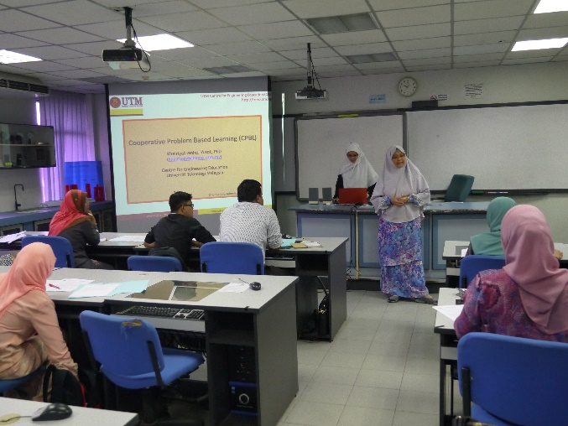
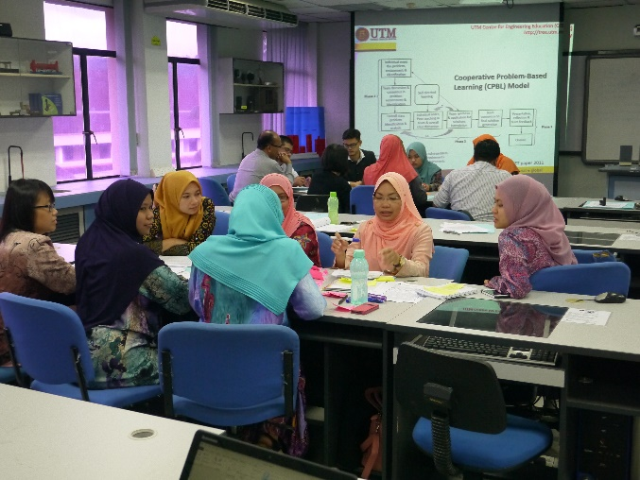
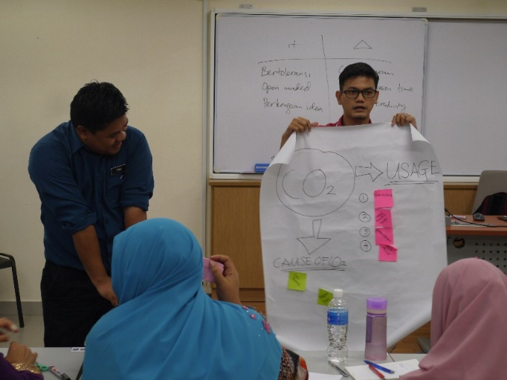
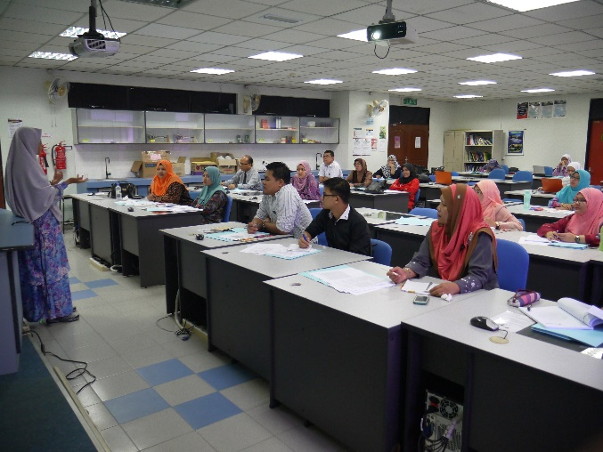
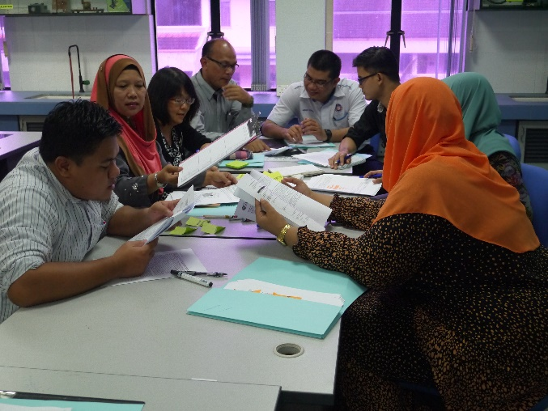
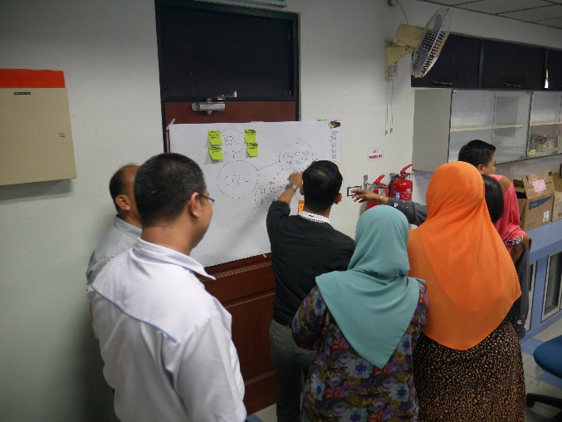
Teacher Training

Slide 8
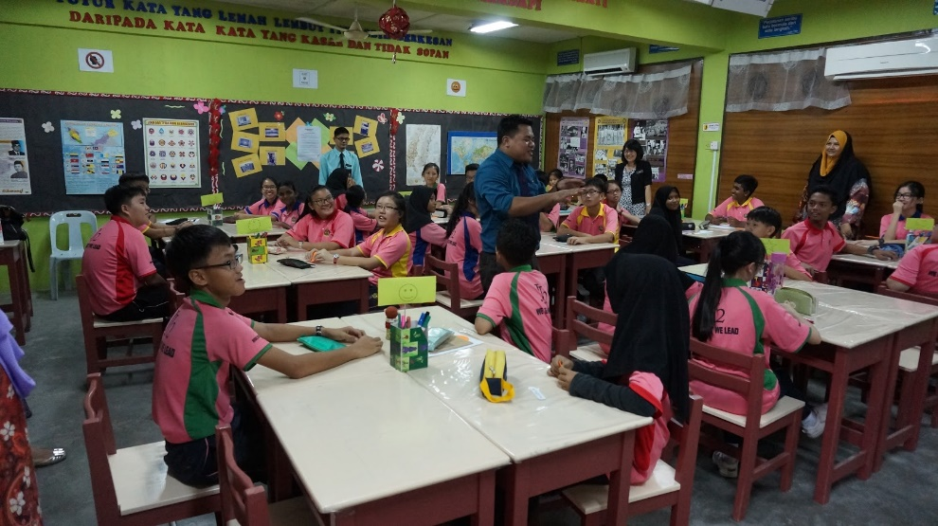
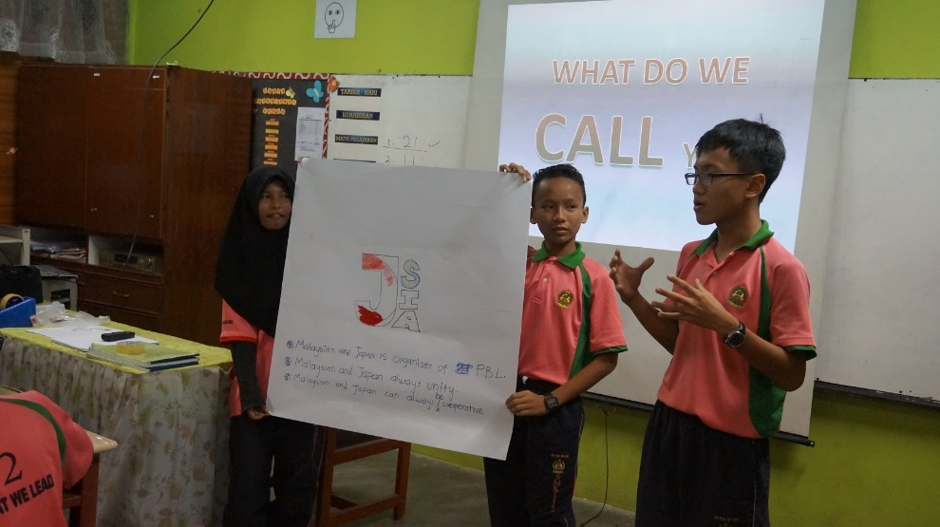
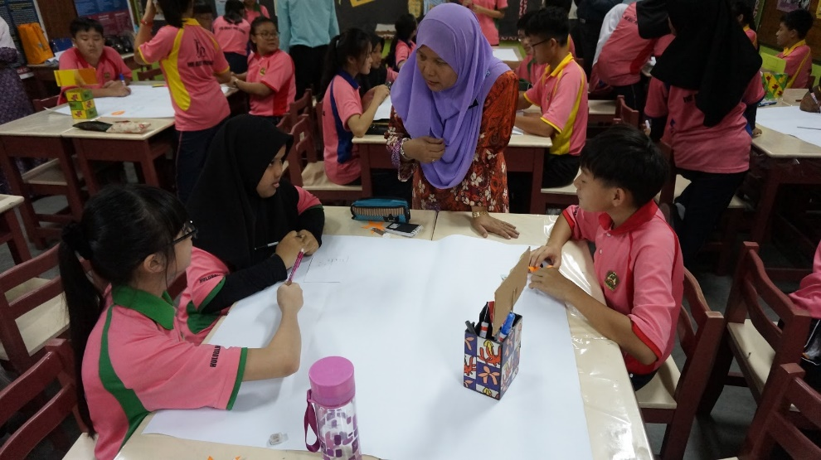
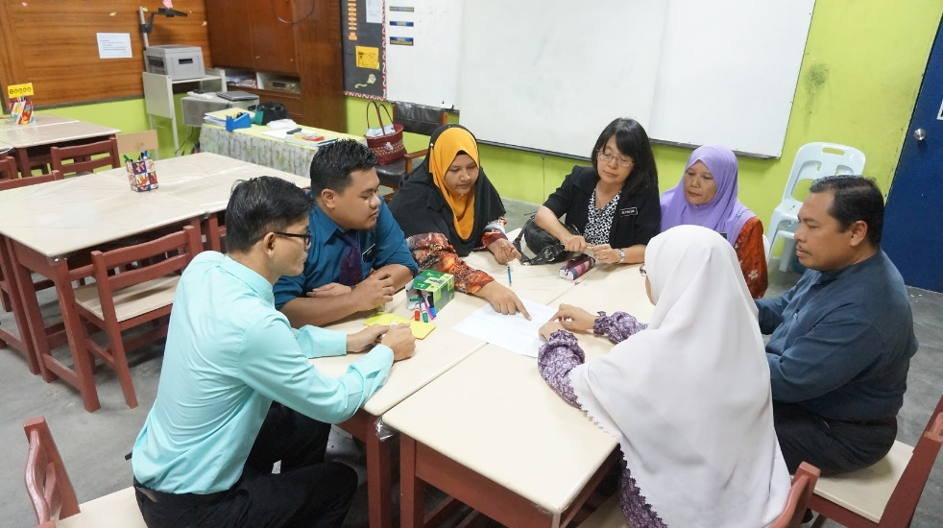
PBL Implementation

