Slide 1
WOMEN EMPOWERMENT EFFORTS IN GBARAIN/EKPETIAMA CLUSTER DEVELOPMENT BOARD COMMUNITIES
Women empowerment initiative implementation status in Gbarian/Ekpetiama cluster development area, Bayelsa state, Nigeria
By
Chief Dr. Kwen Keme-Iderikumo
Chairman, Gbarain/Ekpetiama Cluster Development Board representing members of the Cluster board
A community based group affiliate with RCE Greater Yenagoa
And
Sir Anthony Wakwe Lawrence
Chairman, Community Inter-Relations and Conciliation Initiative
And Coordinator, RCE Greater Yenagoa

Slide 2
WOMEN EMPOWERMENT EFFORTS IN GBARAIN/EKPETIAMA CLUSTER DEVELOPMENT BOARD COMMUNITIES
INTRODUCTION/BACKGROUND
The Gbarain/Ekpetiama Cluster is made up of: ten Gbarain clan communities namely: Polaku, Koroama, Obunagha, Okolobiri, Ogboloma, Ayama, Okotiama, Nedugo, Agbia and Kumboama and Gbarantoru community of Ekpetiama clan.
They are all Ijaw speaking communities within the RCE Greater Yenagoa network area in Bayelsa state.
The Gbarain/Ekpetiama development cluster is one of many such clusters being managed by Shell Petroleum Development Company of Nigeria Limited (SPDC) in Nigeria.
SPDC entered into a Global Memorandum of Understanding with this cluster in December 2012 to last for 5 years, in which the company agreed to contribute the sum of N125,000,000 (which is about $347,222 USD) annually, for the period of five years, for community development.
The Cluster Development Board formed to manage community development and relationships between the company and the communities is made of the Chairmen, Secretaries and the Treasurers of the eleven community bodies called Community Trusts.

Slide 3
WOMEN EMPOWERMENT EFFORTS IN GBARAIN/EKPETIAMA CLUSTER DEVELOPMENT BOARD COMMUNITIES
The board also has SPDC, Government and the facilitating NGO representatives on board.
The above scenario empowers the Communities to be in charge of problem evaluation and needs assessment, the identification of interventions based on available funding situation and project implementation supervisions
A number of times, community developmental interventions exclude women from directly benefiting as stakeholders. This is due to several cultural and religious factors that discriminate against women and thus impede their active involvement even for development interventions that are expected to directly benefit them.
Recent developmental approaches have recognized these issues and are making deliberate efforts for greater participation of women and are putting in place policies that ensure that women are consulted and are active participants in community development.

Slide 4
WOMEN EMPOWERMENT EFFORTS IN GBARAIN/EKPETIAMA CLUSTER DEVELOPMENT BOARD COMMUNITIES
The foregoing has been the case too for this cluster. To that effect, SPDC and the cluster Board had ensured the following:
That the ten-man Community Trust in each community has at least 3 women members.
Since the Chairman, Secretary and Treasurer of each Community Trust are members of the supervising Cluster Development Board, the treasurer of each Community Trust must be a woman, so that she automatically becomes a member of the board at the cluster level.
That 15% of funds contributed for community development in the community, and in this case by SPDC, is used for women empowerment interventions.
Encouraging women to come together and collectively work to achieve commonly set goals and objectives and in this case construction of building projects in the communities.

Slide 5
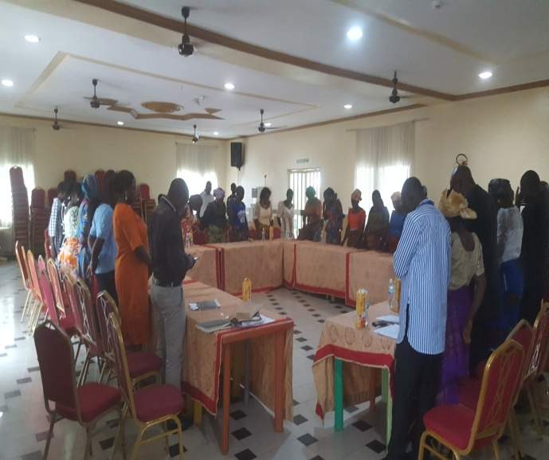
WOMEN EMPOWERMENT EFFORTS IN GBARAIN/EKPETIAMA CLUSTER DEVELOPMENT BOARD COMMUNITIES
Women, during the community town hall meetings and also in the focused group discussions, identified access to finance as one of their priority developmental challenges and focused on income generating projects as a way to raise some finance for their collective use.
All the communities agreed to invest in housing for letting as a means of sustainable income generating project since their communities are expanding due to influx of people involved in the oil industry and other businesses in the area resulting in acute accommodation problems.
Planning meeting by SPDC/Gbarain/Epketiama CDB/NGO representatives with Women of the communities.

Slide 6
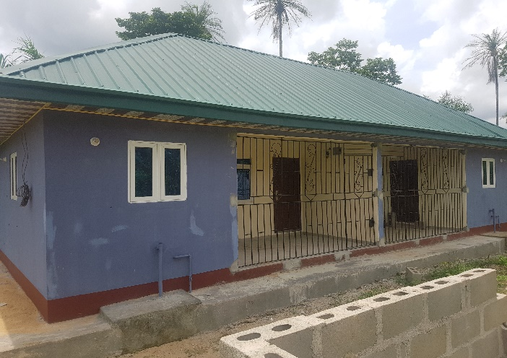
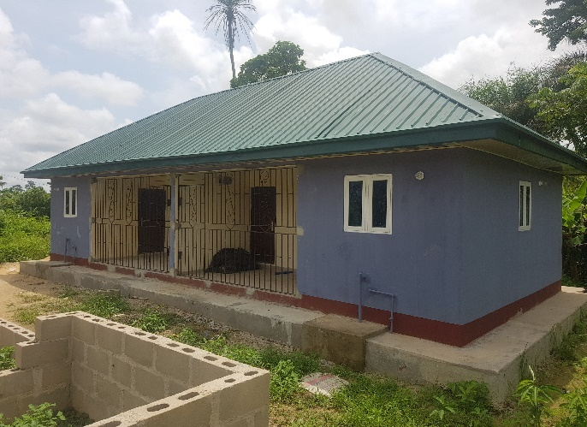
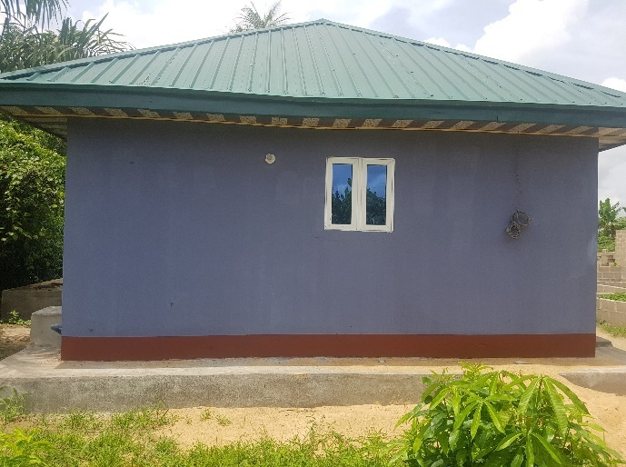
WOMEN EMPOWERMENT EFFORTS IN GBARAIN/EKPETIAMA CLUSTER DEVELOPMENT BOARD COMMUNITIES
PROJECT IMPLEMENTATION STATUS
GBARANTORU
CONSTRUCTION OF TWO (2) UNITS SELF-CONTAIN APARTMENTS IN GBARANTORU

Slide 7
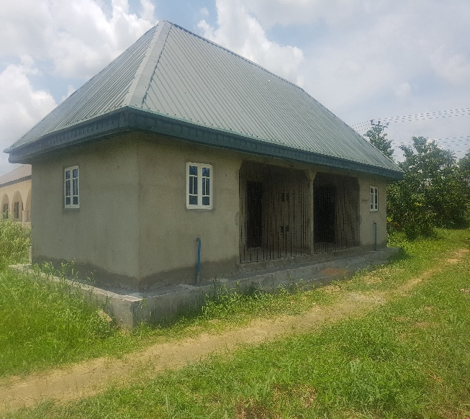
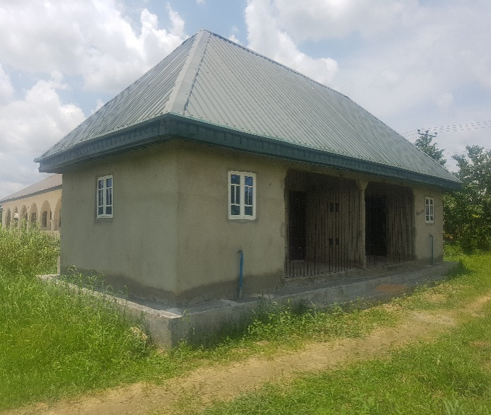
WOMEN EMPOWERMENT EFFORTS IN GBARAIN/EKPETIAMA CLUSTER DEVELOPMENT BOARD COMMUNITIES
AYAMA COMMUNITY
CONSTRUCTION OF TWO (2) UNIT OF FOUR (4) SELF-CONTAIN APARTMENTS IN AYAMA
Ongoing Construction of 2 units of I Self Contained apartments by Ayama Women Forum

Slide 8
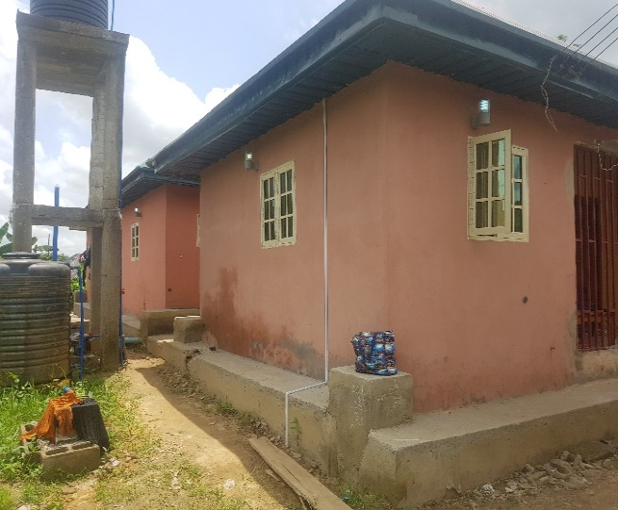
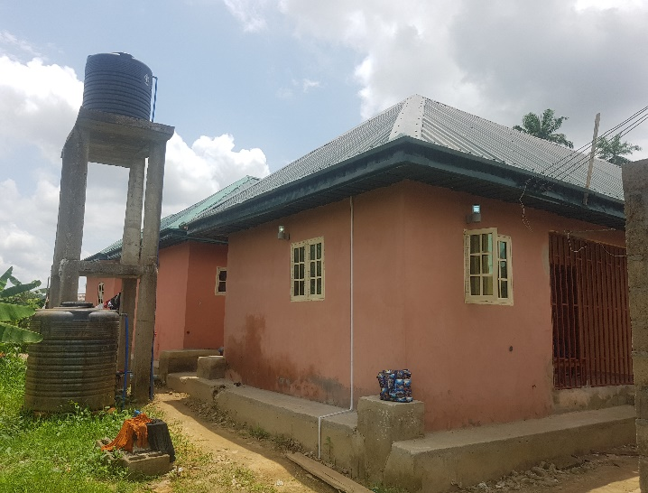
WOMEN EMPOWERMENT EFFORTS IN GBARAIN/EKPETIAMA CLUSTER DEVELOPMENT BOARD COMMUNITIES
OBUNAGHA COMMUNITY
CONSTRUCTION OF THREE (3) UNITS OF SIX (6) SELF-CONTAIN APARTMENTS IN OBUNAGHA
Ongoing Construction of 3unit of 6 Self Contained apartments by Obunagha Women Forum

Slide 9
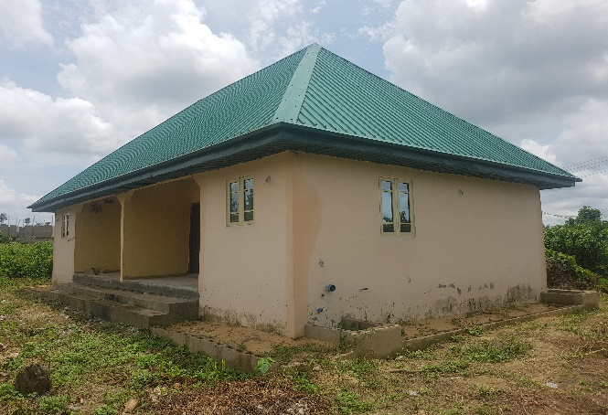
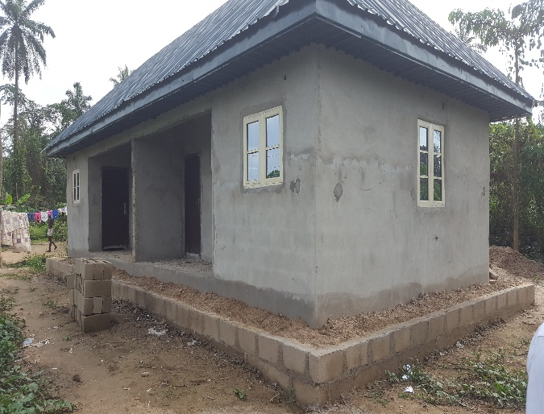
WOMEN EMPOWERMENT EFFORTS IN GBARAIN/EKPETIAMA CLUSTER DEVELOPMENT BOARD COMMUNITIES
KOROAMA COMMUNITY
OKOLOBIRI COMMUNITY
Ongoing Construction of 2 self-contain apartments in Koroama
Ongoing Construction of 2 self-contain apartments in Okolobiri

Slide 10
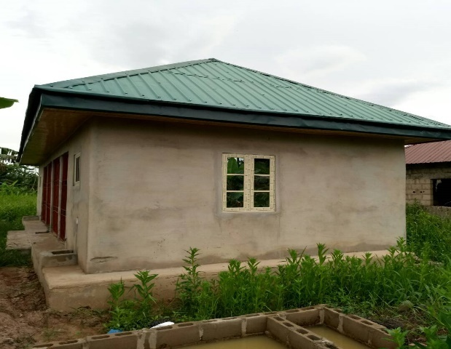
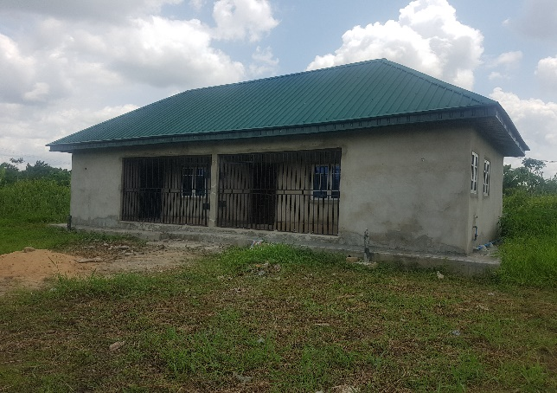
WOMEN EMPOWERMENT EFFORTS IN GBARAIN/EKPETIAMA CLUSTER DEVELOPMENT BOARD COMMUNITIES
POLAKU COMMUNITY
NEDUGO COMMUNITY
Ongoing Construction of 2 units 4 Self-Contain in Polaku
Ongoing Construction of 2 units Self-Contain in Nedugo

Slide 11
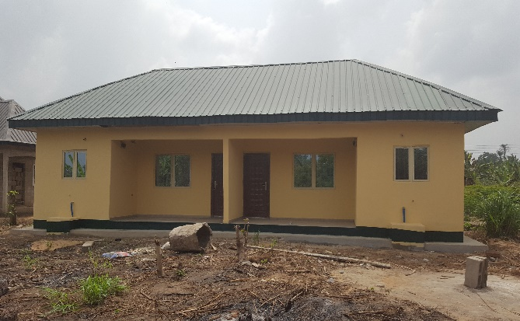
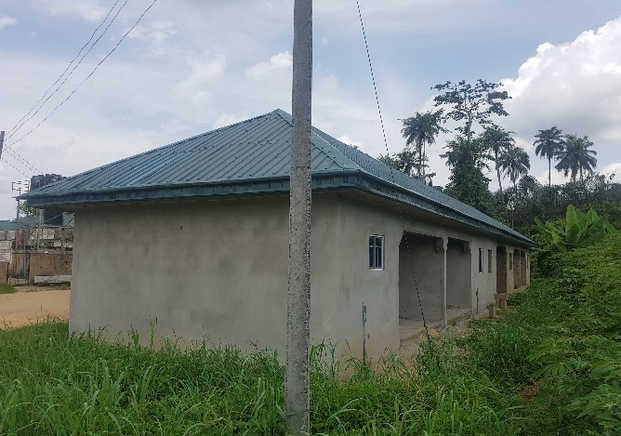
WOMEN EMPOWERMENT EFFORTS IN GBARAIN/EKPETIAMA CLUSTER DEVELOPMENT BOARD COMMUNITIES
OKOTIAMA COMMUNITY
AGBIA COMMUNITY
Completed construction of 2 units Self-contain apartments in Okotiama community
Ongoing construction of 1 unit Self-contain apartments in Agbia community

Slide 12
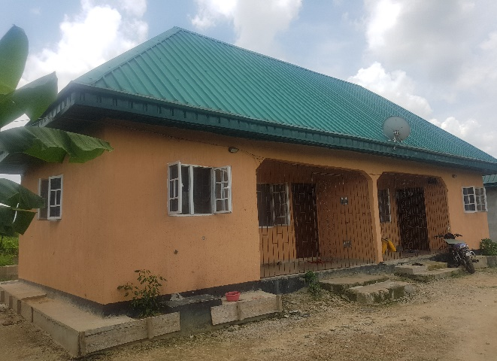
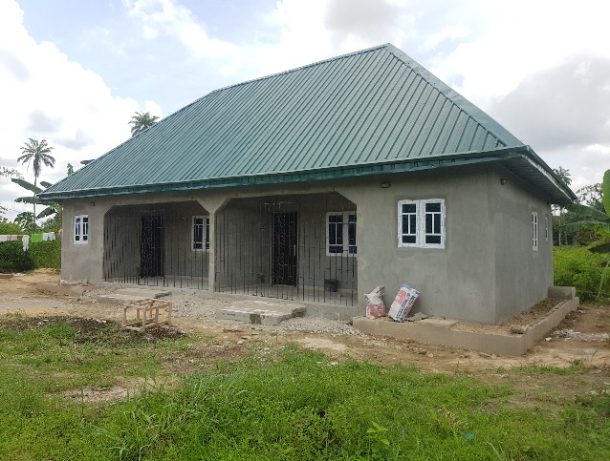
WOMEN EMPOWERMENT EFFORTS IN GBARAIN/EKPETIAMA CLUSTER DEVELOPMENT BOARD COMMUNITIES
OGBOLOMA COMMUNITY
COMPLETION OF SELF-CONTAIN FLATS AT OGBOLOMA COMMUNITY IN OGBOLOMA
Completed Ongoing construction of 2 units
Self-contain

Slide 13
WOMEN EMPOWERMENT EFFORTS IN GBARAIN/EKPETIAMA CLUSTER DEVELOPMENT BOARD COMMUNITIES
PROJECT MONITORING / EVALUATION VISITS:
ASSESSING WOMEN PERCEPTION OF PROJECT
We visited the communities and engaged them individually and collectively.
We interviewed them to generate information on the following:
Assess their perception of how well the projects are being implemented
Find out if they are getting value for money spent
Find out if the project is achieving the objectives they had set for themselves in implementing the project
Identify other challenges that the project implementation has brought about

Slide 14
WOMEN EMPOWERMENT EFFORTS IN GBARAIN/EKPETIAMA CLUSTER DEVELOPMENT BOARD COMMUNITIES
COST OF PROJECT
Each twin self-contain building costs about 5,200,000 Naira (about 14,444 USD on current exchange rate) on the average.
This is reasonable cost, considering current prices of building materials in the area
FINDINGS
Women are happy that they implemented the projects themselves and are doing a good job.
Women felt they are building the projects frugally and they discipline anyone who fails to deliver.
Women are happy they were empowered to implement their own projects
They showed self-worth doing these projects with the minimal finances available
They showed enthusiasm that with time they would be able to generate enough finances to resolve some of their collective women needs by themselves,

Slide 15
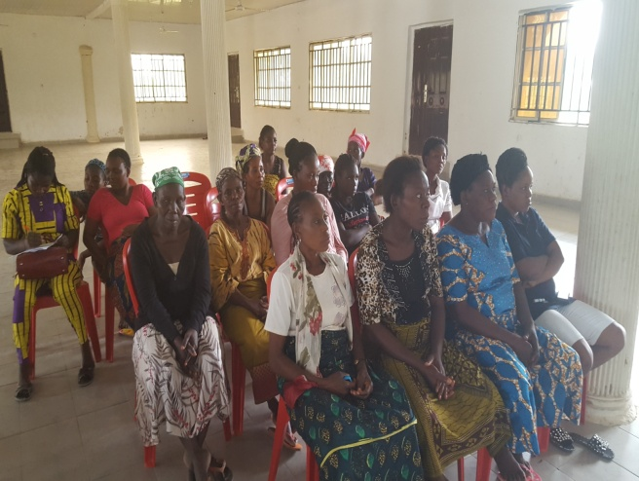
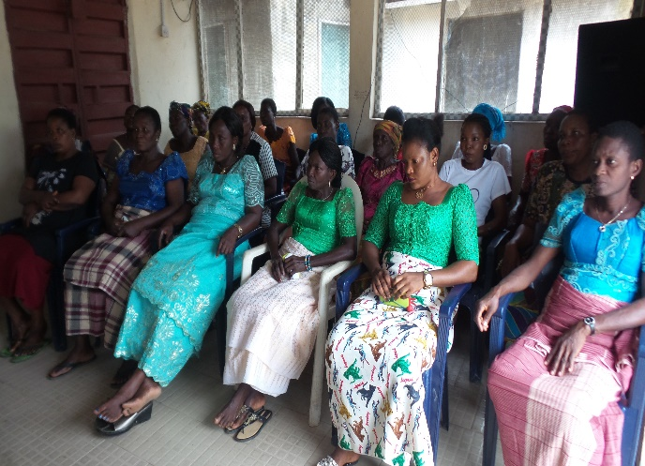
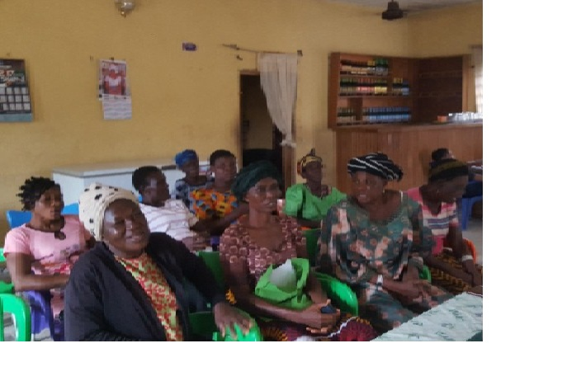
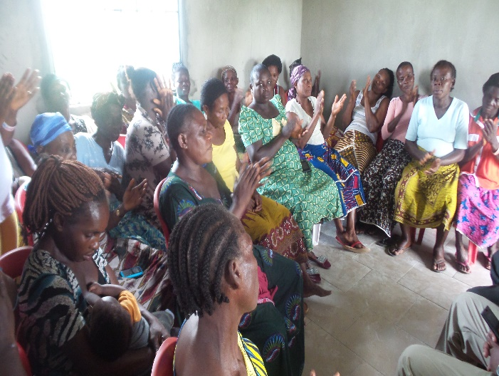
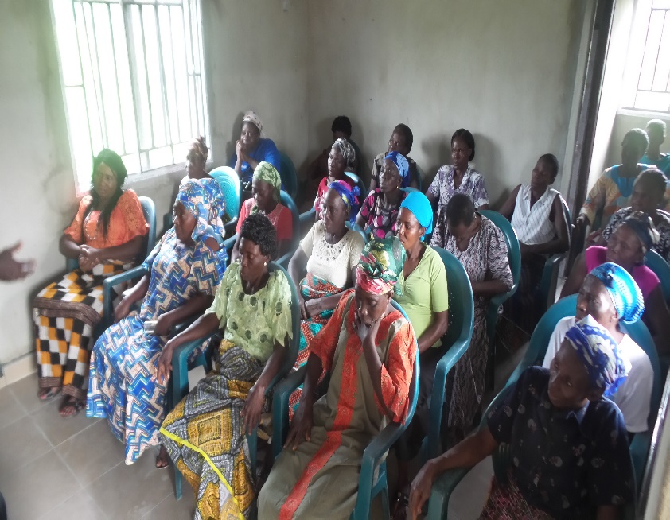
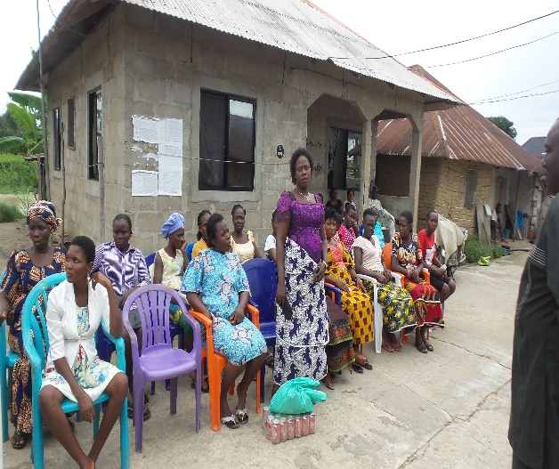
WOMEN EMPOWERMENT EFFORTS IN GBARAIN/EKPETIAMA CLUSTER DEVELOPMENT BOARD COMMUNITIES
Visit to Gbarantoru women representatives
Visit to Obunagha women representatives
Visit to Ayama women representatives
Visit to Nedugo women representatives
Visit to Koroama women representatives

Slide 16
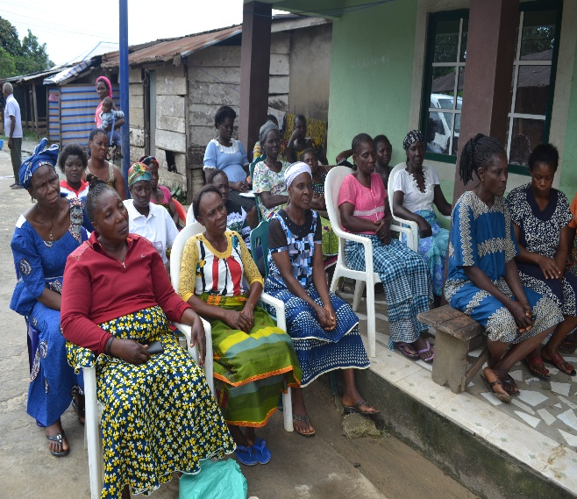
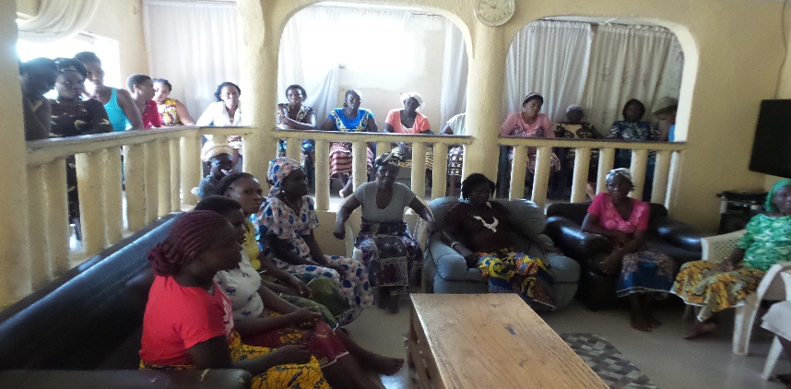
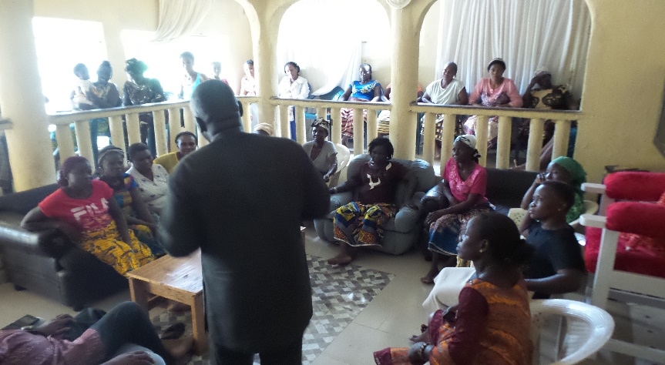
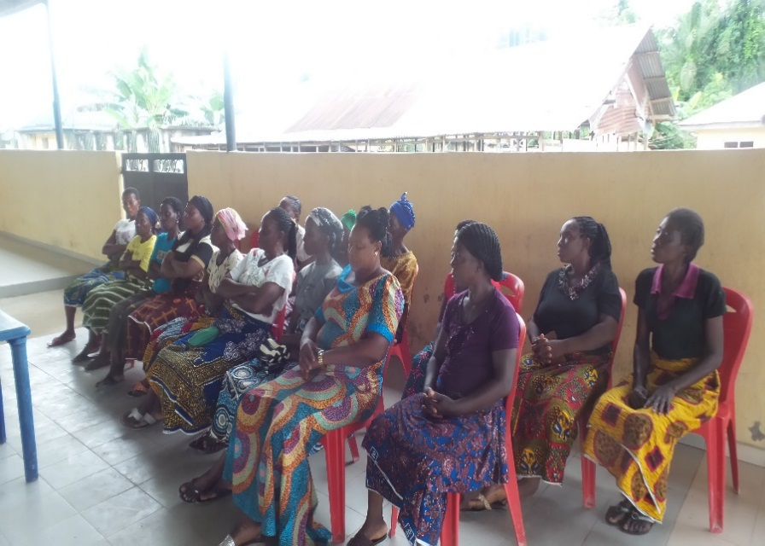
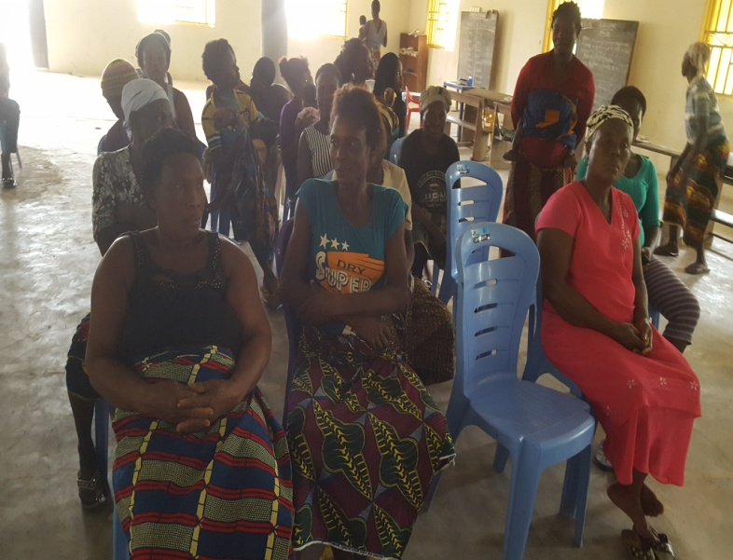
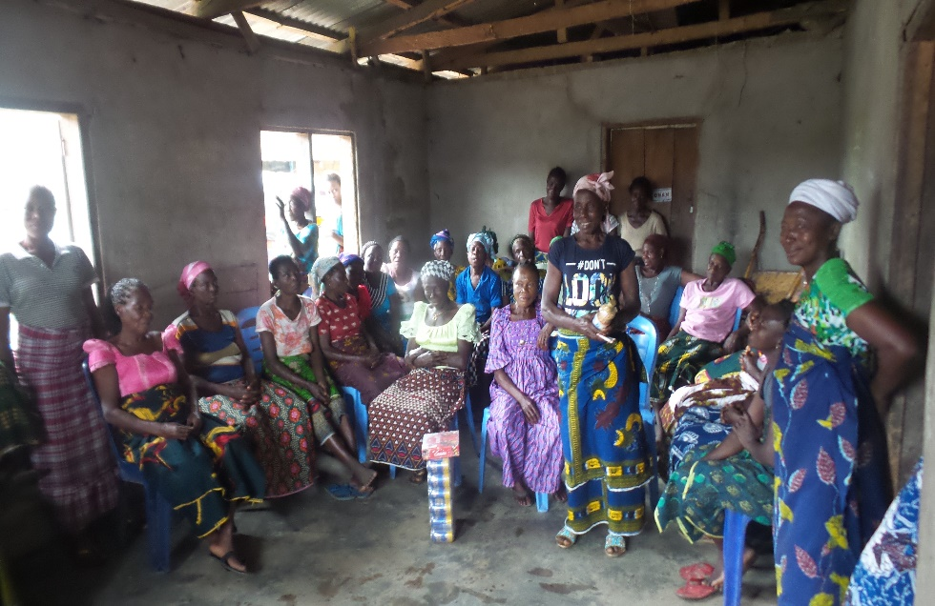
WOMEN EMPOWERMENT EFFORTS IN GBARAIN/EKPETIAMA CLUSTER DEVELOPMENT BOARD COMMUNITIES
Okolobiri women representatives
Visit to Polaku women representatives
Visit to Agbia women representatives
Visit to Okotiama women representatives
Visit to Ogboloma women representatives

Slide 17
WOMEN EMPOWERMENT EFFORTS IN GBARAIN/EKPETIAMA CLUSTER DEVELOPMENT BOARD COMMUNITIES
WAY FORWARD
There is some progress in the effort to empower women and give them a voice in our communities, further actions are, however, needed as proposed below:
Though the housing projects being implemented by the women are aimed at generating income and improving their financial situation, it is important that they are mentored to diversify their efforts towards implementing more capacity building interventions and educational support for the girl-child.
In order to continuously improve the situation, we intend to advocate for increased participation of women in community governance.
Advocate that, just as we have organized male youth associations in the communities, we should equally have female youth associations to cater for the specific developmental and political needs of the female youths.

Slide 18
WOMEN EMPOWERMENT EFFORTS IN GBARAIN/EKPETIAMA CLUSTER DEVELOPMENT BOARD COMMUNITIES
WAY FORWARD
Advocate that education support, scholarship and bursary assistance to indigent community girls be given some recognition and priority.
Advocate for skill acquisition programmes for girls as well as for male youths.
There are 3 community based organizations that have so far affiliated to RCE Greater Yenagoa namely: Gbarain/Ekpetiama Cluster having 11 communities, Okordia/Zarama Cluster having 9 communities and Kolo Creek cluster having 4 communities. All of them are eager to host interventions towards the developmental advancement of women and youth and we shall be grateful to partner with any legally acceptable group in the world that wants to help us achieve our developmental goals.
To ensure sustainability and ensure project maintenance, women will agree how best to utilize/reinvest the income that will be generated from the project when in use.

Slide 19
WOMEN EMPOWERMENT EFFORTS IN GBARAIN/EKPETIAMA CLUSTER DEVELOPMENT BOARD COMMUNITIES
CONCLUSION
We commend SPDC and her joint venture partners for giving back to the communities in their operational areas.
NGO and CDB representatives also sensitized the groups on relevant sustainable issues and provided answers to questions asked.
Development activities must combine both infrastructure with human capital and economic development.
To ensure sustainability, the people’s capacities in project management and maintenance is critical
The people’s economic capabilities must be enhanced so that they do not imbibe dependency mentality.

Slide 20
WOMEN EMPOWERMENT EFFORTS IN GBARAIN/EKPETIAMA CLUSTER DEVELOPMENT BOARD COMMUNITIES
We seek partnership with other donors to help these women in other areas of their interest including:
business development and financing,
skill and talent development,
scholarship schemes,
health awareness campaigns, free medical check-ups and medical intervention outreaches and
establishment of cottage industries like cassava and oil palm processing mills among others
These projects have direct impact on the people and their socio-economic wellbeing.

