Slide 1
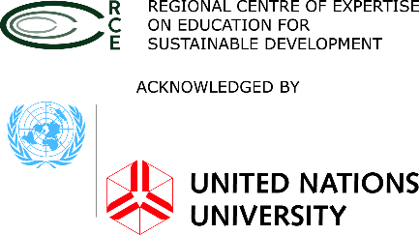
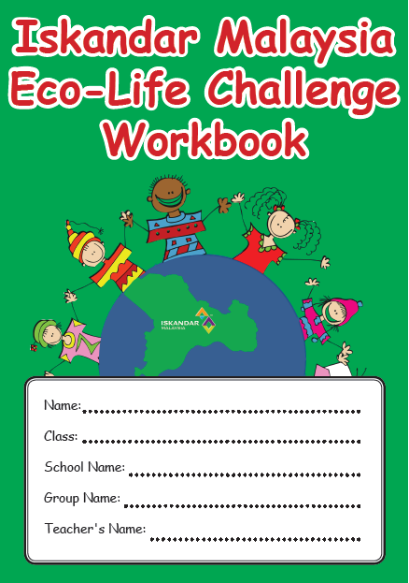
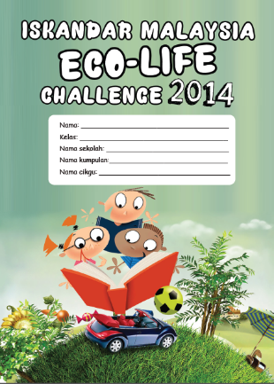
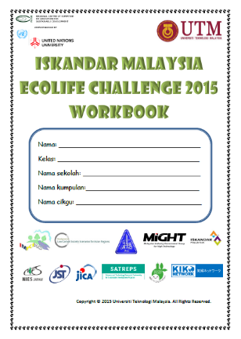
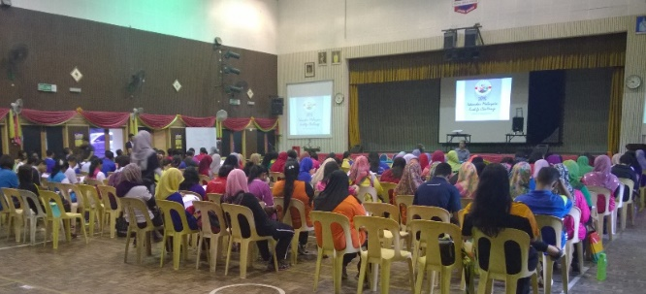
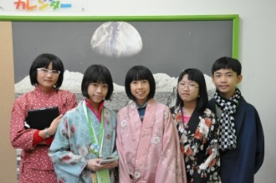
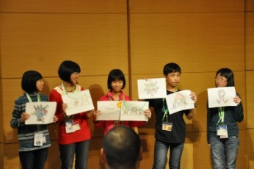
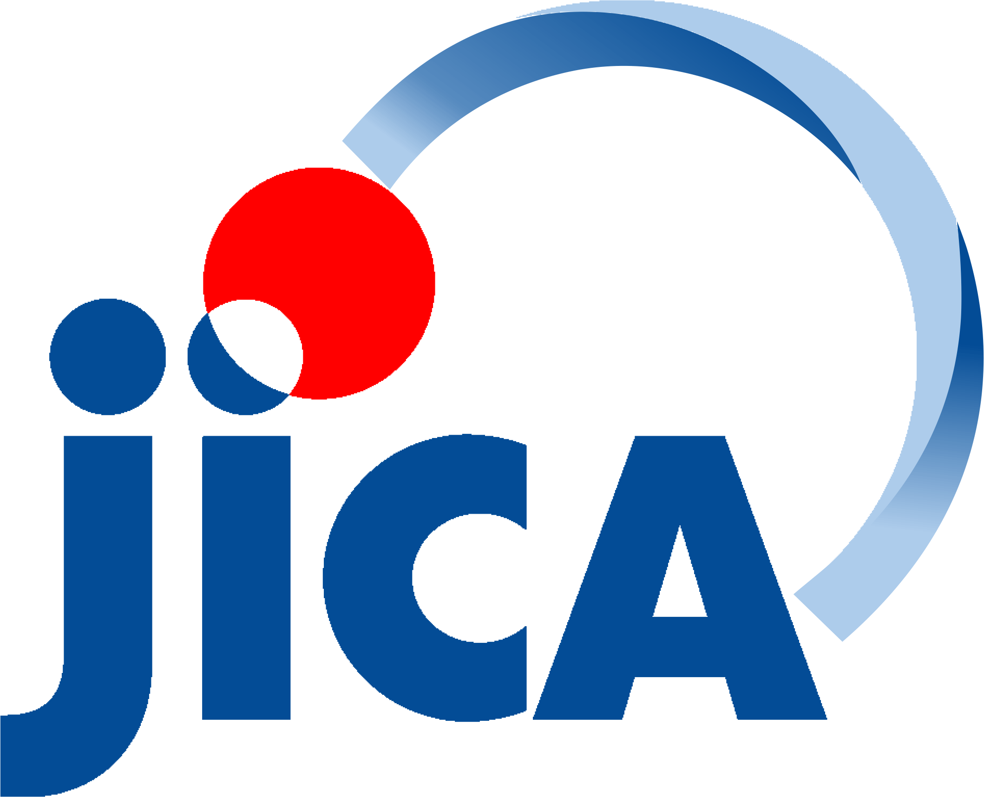
ECO-LIFE
CHALLENGE
IMELC 2013-2014 ACHIEVEMENT
Increase of students’ awareness & practice on low carbon
The surveys conducted on all the participating students before and after the activities of the workbook show an average increase of 17% in 2014.
Increase of teachers’ knowledge and awareness on low carbon
The surveys conducted on all the participating teachers before the teacher training and after the activities of the workbook show and average increase of 4.5% in 2014.
Carbon reduction
The electricity and water saving module reduces up to an average of 1,421kg of CO₂ for a school in a month. If the amount is multiplied to all primary schools in Iskandar Malaysia (226), a total of 321ton of CO₂ can be reduced in a month.
Recycling
A total of 45,540kg of waste is recycled in a month.
ISKANDAR MALAYSIA
Malaysia has pledged a 40% reduction of its greenhouse gases (GHG) emission intensity by year 2020 (based on 2005 emission baseline). Iskandar Malaysia, through creating a Low Carbon Society, has joined the effort to reach the goal. “Children’s Eco-Life Challenge” is one of the many programmes that work towards realizing the vision, as well as contributing to the global effort in addressing global warming.
ECO-LIFE
CHALLENGE
(IMELC)
Through the challenges (activities) in Eco-Life Challenge, children will learn about the connection between their daily lifestyle and its effect on the environment (such as global warming). They will have the opportunity to learn ways to reduce carbon emission by making informed decision on their choices of lifestyle. Children can share their knowledge and understanding with their family.
①④Teacher training session
*All the data is published and detailed out in Phang et al. (2015). Iskandar Malaysia Ecolife Challenge: Low carbon education for teachers and students. Presented at the International Conference on Low Carbon Asia 2015 on 11-13 Oct 2015.
②Champions visiting Kyoto
UTM-Low Carbon Asia Research Center
Level 2, Block B12, Faculty of Built Environment
Universiti Teknologi Malaysia,
81310 UTM Johor Bahru, Johor, Malaysia
Tel/Fax: +607-5537356
www.utm.my/satreps-lcs
Cpyright © 2015 Universiti Teknologi Malaysia – All Rights Reserved

Slide 2
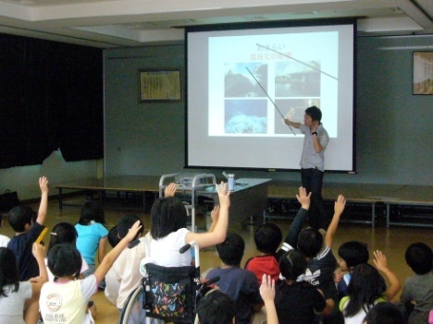
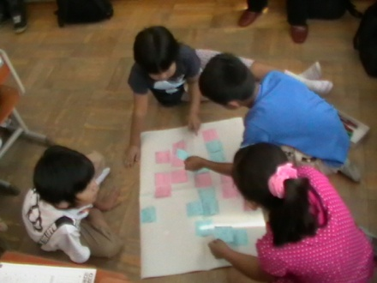
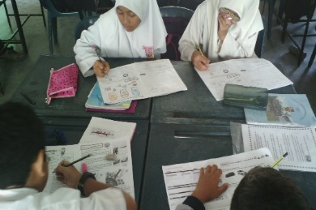
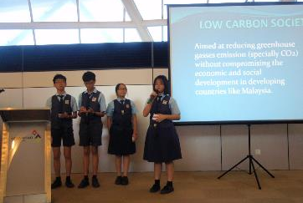
Children’s Eco-Life Challenge
Iskandar Malaysia
Eco-Life Challenge
Components of IMELC
こども エコライフ チャレンジ
Iskandar malaysia
KYOTO city
ELC workbook
Starts
Starts
The ELC workbook contains activities that revolve around children’s daily life that is related to greenhouse gas emission (carbon emission).
Year 2005 with 1 school to all public elementary schools (177) in Kyoto City in year 2010 (until now)
Year 2013 with 23 schools to all public primary schools (226) in Iskandar Malaysia in 2015
Energy consumption
Transportation
3R
Partnership / organization
Partnership / organization
Kyoto City Council, Kyoto City Board of Education, KIKO Network, Miyako Ecology Centre
Johor State Education Department (JPNJ),
IM KIKO, Iskandar Regional Development Authority (IRDA), Universiti Teknologi Malaysia (UTM)
Electricity
Fuel usage
Eco-label
Water
Renewable energy sources
Eco-Life
Participants
Participants
4th to 6th graders (age 10-12) in all public elementary schools
Standard 6 students (age 12) in all public primary schools, as post-UPSR programme
Learning cycle
Learning format
School projects
Preliminary learning sessions
Practical sessions
Reflective learning sessions
Continuation development
Students in school work together to save electricity usage at school through campaigns and activities
Preliminary learning sessions
Practical sessions: School projects
Practical sessions – ELC workbook
Oral presentation (Competition)
Electricity savings
Students in school work together to save water usage at school through campaigns and activities
Water savings
Students work together to collect recyclables from home and school. Students learn about waste segregation.
Recycling
Students and teachers work together to green the school compound through growing more plants.
Tree planting

