Slide 1
THE 7th INTERNATIONAL (VIRTUAL) WORKSHOP ON UI GREENMETRIC WORLD UNIVERSITY RANKINGS 24-26 August 2020 Universiti Putra Malaysia, Malaysia
KBAD- A Real Time Opportunity for Sustainability Education in COVID-19
Prof. Selina Nargis, Dr. Muhammad Rehan Dastagir*, Dr. Ferdous Ahmed, Dr. Sayma Akhter, Prof. Mohammed Ataur Rahm
IUBAT Institute of SDG Studies
IUBAT—International University of Business Agriculture and Technology,
Dhaka, Bangladesh
*Email of the corresponding author: rdastagir@iubat.edu

Slide 2
Introduction
Tertiary education is the highest level of education of a country
Tertiary education is not equally accessible to all in the world
The is the shortcoming of higher education addressed in SDG-4.3
The COVID-19 pandemic situation worsen this target of students’ enrolment, drop-out and overall quality in education

Slide 3
University enrollment increased in Bangladesh though lagged behind in the South Asian region ( World Bank, 2016)
The reasons behind are:
1. Lacking quality education among secondary students finds difficulty in continuation of tertiary education
2. Urban centric development creating distance from rural students
3. Higher cost of Education

Slide 4
Scenarios of Bangladesh
There are 53 public and 107 private universities in the country
Private universities are in rise due to limited in number of seats in public
Cost of private universities is high for the middle class
Distribution of private universities are uneven and capital centric ( 51 in Dhaka division)
Although Bangladesh has a high student enrolment in schools ( Primary 98%), the quality of education low
A weak background in English, mathematics and critical thinking made the students incompetent for tertiary education

Slide 5
Tertiary Education the question of equal access for all?
SDG Target 4.3: By 2030, ensure equal access for all women and men to affordable and quality technical, vocational and tertiary education, including university
SDG Target 4.4: By 2030, substantially increase the number of youth and adults who have relevant skills, including technical and vocational skills, for employment, decent jobs and entrepreneurship
SDG Target 4.7: By 2030, ensure that all learners acquire the knowledge and skills needed to promote sustainable development, including, among others, through education for sustainable development and sustainable lifestyles, human rights, gender equality, promotion of a culture of peace and non-violence, global citizenship and appreciation of cultural diversity and of culture’s contribution to sustainable development

Slide 6
For Equal Access of Tertiary Education
University should not be
University should work as

Slide 7
IUBAT is working for Equal Access of Tertiary Education through KBAD
KBAD means Knowledge Based Area Development
A Concept Postulated by
Professor M Alimullah Miyan in 2003
Published in 2008
A Step Towards Community Self-Reliance
A UN Flagship Project for Lifelong Learning & ESD

Slide 8
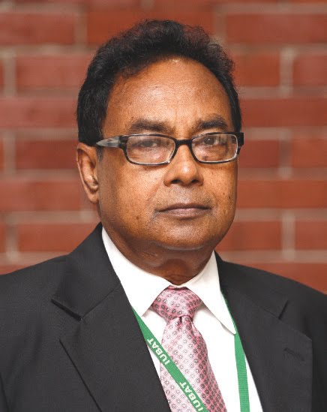
Professor M Alimullah Miyan the Proponent of KBAD

Slide 9
How KBAD Works?
Three Steps
Outreach of Education in Rural Areas
Mentoring students with specialized curricula
Education Financing

Slide 10
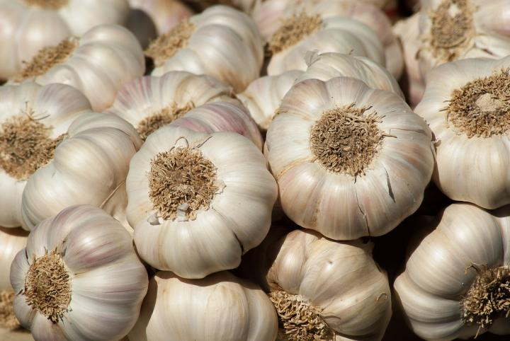
Step 1: Outreach of Education in Rural Areas
KBAD is to Produce at least One Skilled Graduate from Each 87,963 Villages of Bangladesh
Educated & Skilled individuals will pull-up Family, Neighbors & Village Community
Family bondage is strong in the country as “ Garlic effects”
University Education Extension Unit (UEEU) is working on it

Slide 11
Step 2: Mentoring students with specialized curricula
Due to shortage of skilled teachers, facilities and teaching materials quality education is lacking in primary and secondary education
Rural students needs special grooming to be retained at university
IUBAT offers 13 credits English, 7 credits Mathematics, 5 credits for ART-Art of Living, 3 credits for Basic Computer Skills
Offering basic courses has proven successful to retain rural students and decrease students drop out

Slide 12
Step 3: Education Financing
Financial assistance available for the meritorious and needy students
It does not emphasized on the return capacity or the parental income of the applicants
The students do not need to pay back during their study period at university
A highest CGPA student gets full 100% scholarship and additional 15% tuition fee waiver is provided to female students

Slide 13
KBAD Success Story:
In this program 8,890 graduates and 491 post graduates have been studied (2008-2019)
Each year nearly 1000 students get scholarship, tuition fee waiver or financial assistance
In the COVID-19, an additional 15% tuition fee waiver has been given to all, registration fee deduction 50%, 6 USD funding to all students for mobile data
A total 1.5 crore Taka or 177,200.85 USD has been granted in the pandemic time

Slide 14
Table-1: Financial support for needy students in 2018
Financial Support | Amount in BDT (millions)
Merit Scholarship (Tuition fee waiver) | 164.9
Loan (Interest free) | 20.0
Special Scholarships 71 (No of students) | 0.66
Total | 185.56 m BDT 2.2 m USD

Slide 15
Fig 2: Gender equity among students of IUBAT ( 15% more scholarship for female)

Slide 16
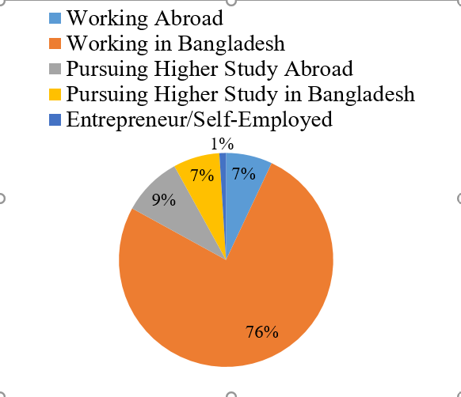
Fig. 3: Employability status of IUBAT graduates Degree programs offer in Agriculture, Business, Engineering, Economics, Tourism, Nursing, English

Slide 17
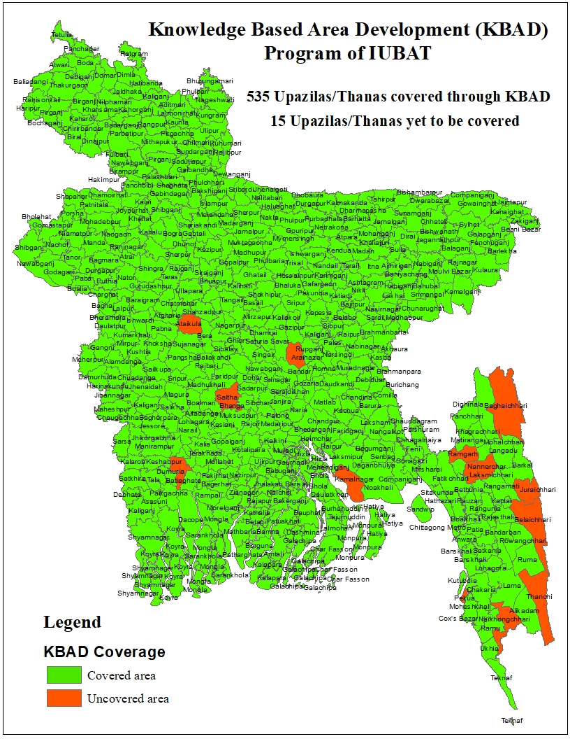
Fig 4: Area coverages of KBAD having students studied at IUBAT Only 15 is left

Slide 18
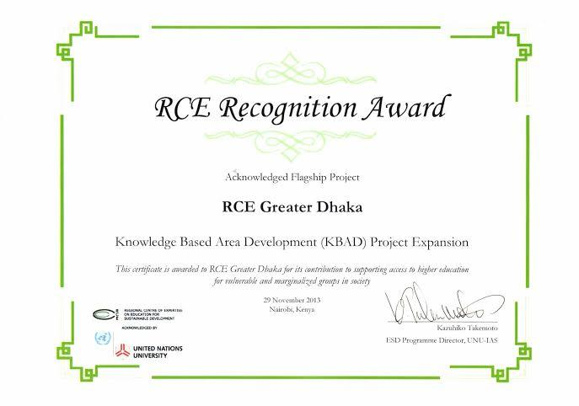
KBAD -a Flagship Project of UNU & RCE

Slide 19
KBAD vs Commercial Banking
KBAD does not consider high parental income or security deposit
It maintains student database
Its not proven as risky, KBAD has high loan return percentage over 90%

Slide 20
Conclusion
Bangladesh in a major transition of socio-economic state
The government is highly committed of SDG targets
The intake of students in the tertiary level has been increased though the quality and affordability of education is under consideration
IUBAT showed a pathway to achieve the accessibility of higher education to all through KBAD program
This was the vision of Prof. Miyan.

