Slide 1
RCE KUCHING Education for sustainable development
rcenetwork.org

Slide 3
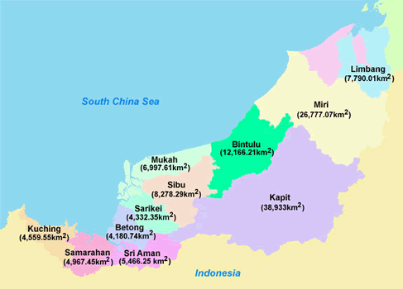
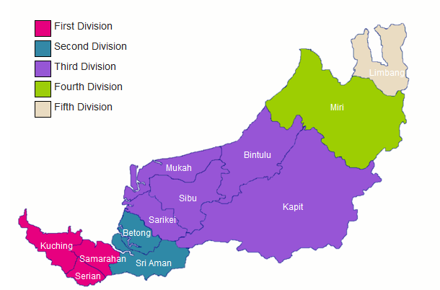
Geographic Region

Slide 4
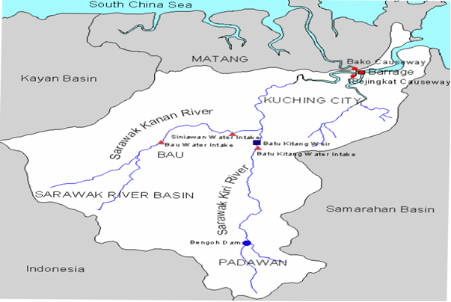
Name of RCE: RCE KUCHING
FOCUS is on:
Communities at the rivers south
of Kuching which are part of the
SARAWAK RIVER (KIRI)
Sarawak River (Kiri)
-Source of water Intake for Kuching City
-Site of Bengoh Dam – Dam is a water reservoir meant to supply water to Kuching, Samarahan and parts of Serian. In Kuching, the Sarawak River Kiri stretches from Batu Kitang all the way to Padawan .

Slide 5
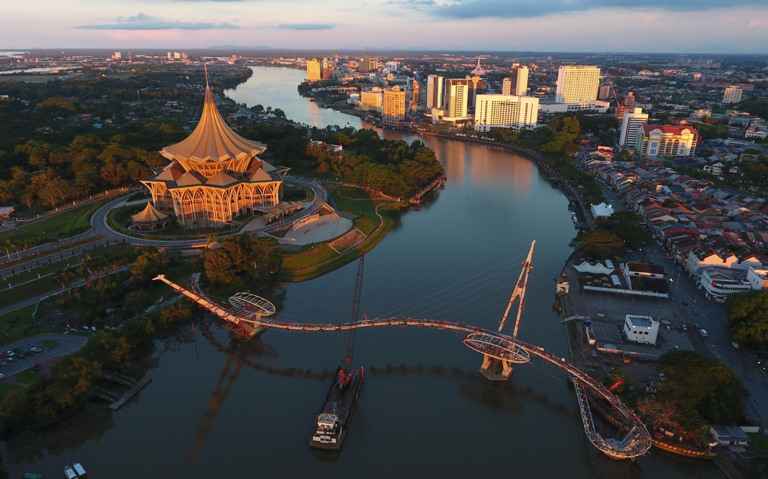
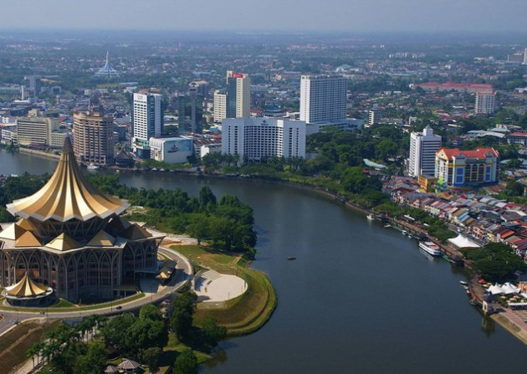
Geographic Region
The Sarawak River flowing through Kuching city centre
Kuching City Centre

Slide 6
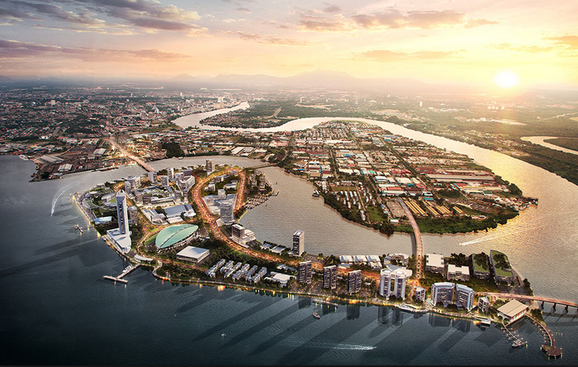
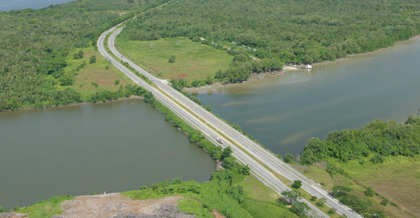
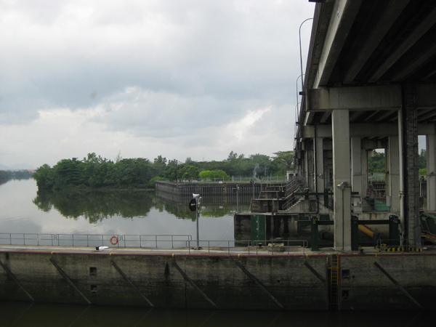
Sarawak River
Sarawak Causeway
Bako Causeway
Kuching Barrage

Slide 7
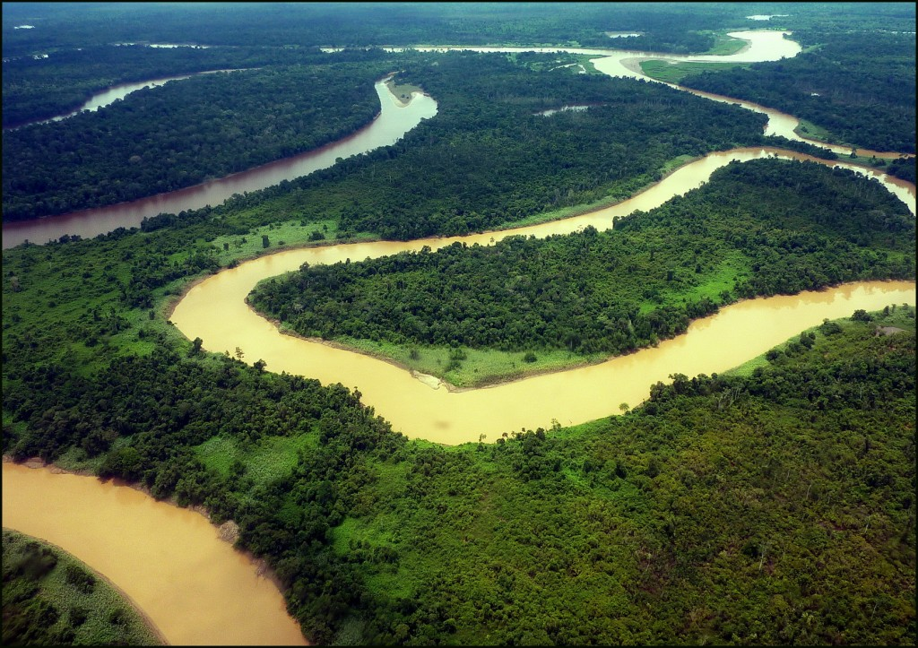
Sarawak River

Slide 8
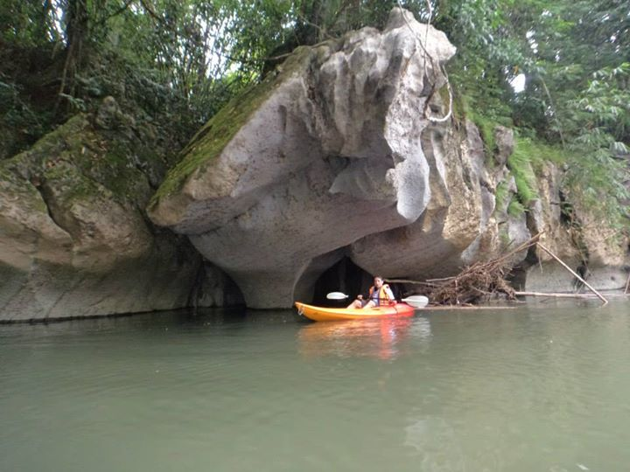
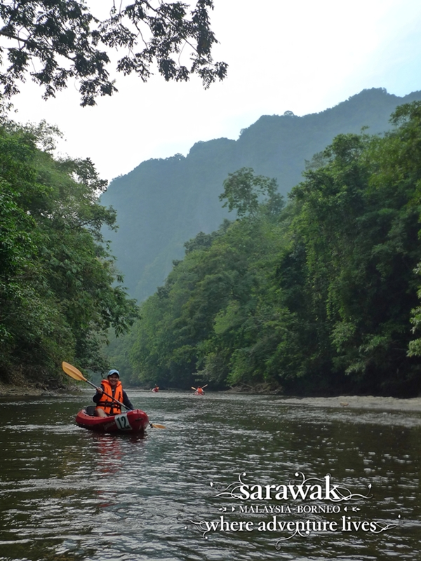
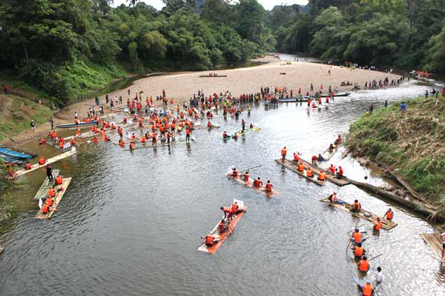
Annual River Raft Safari

Slide 9
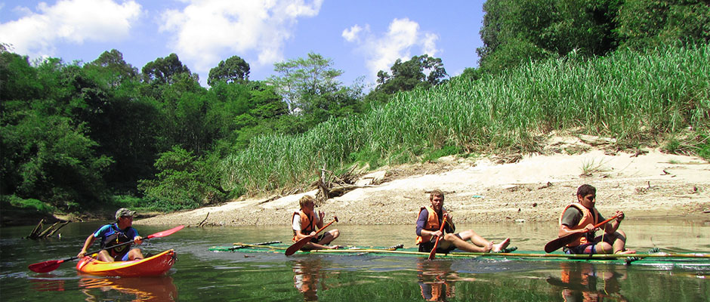
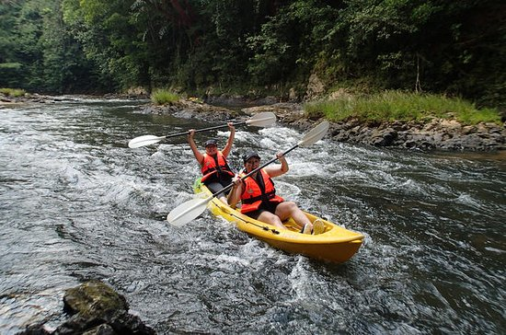
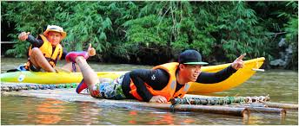
Kayaking / Bamboo Rafting

Slide 10
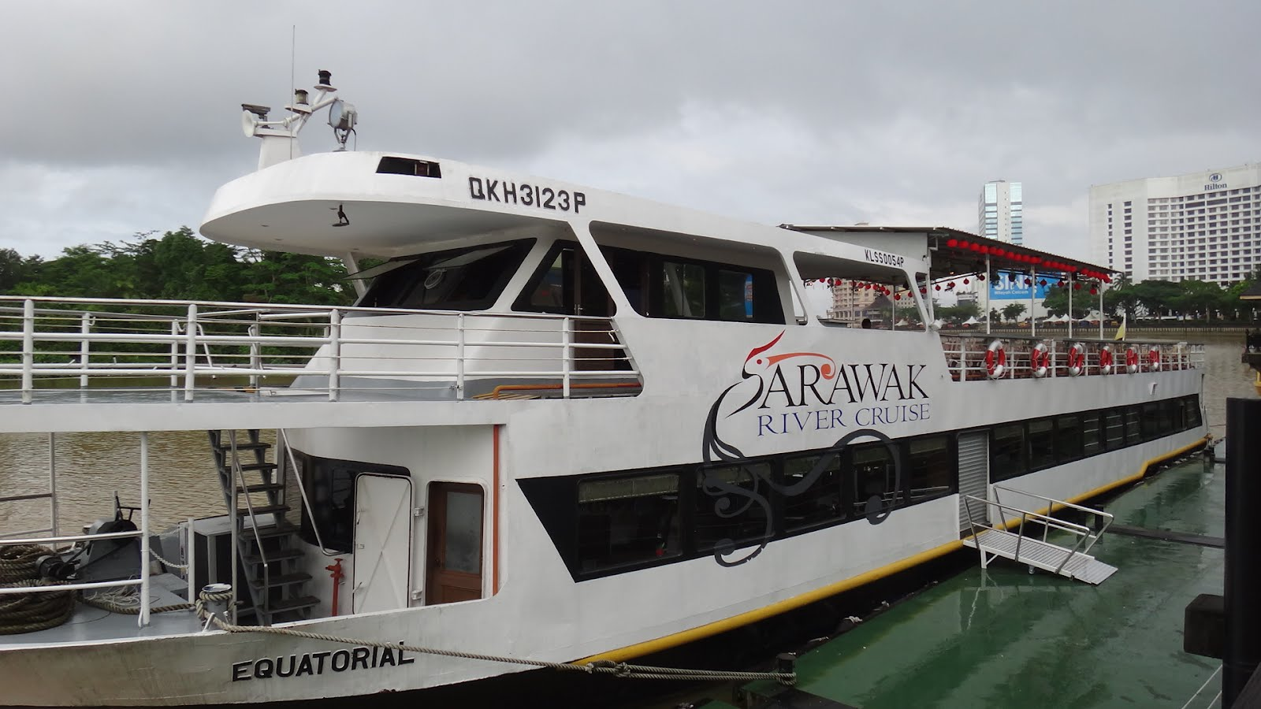
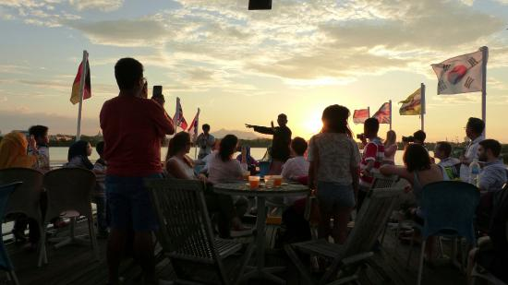
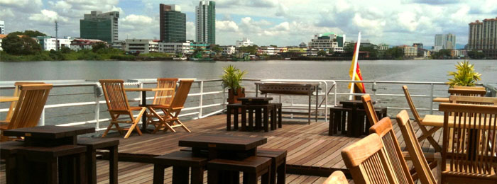
River Cruise

Slide 11
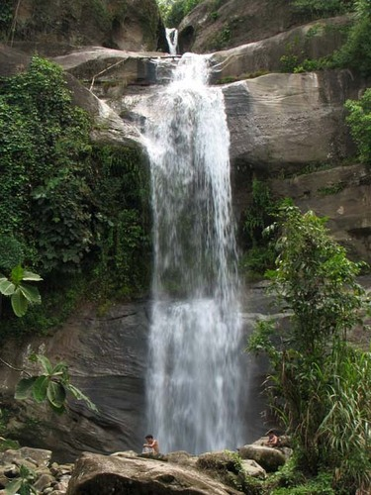
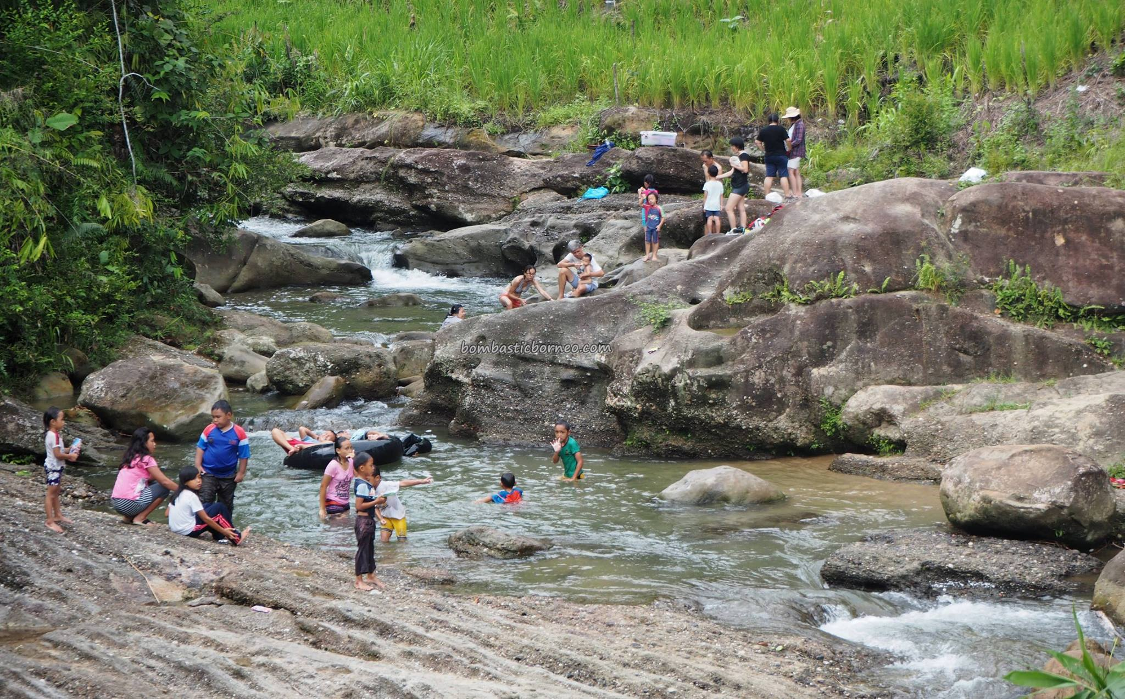
Waterfalls/ Picnic Sites

Slide 12
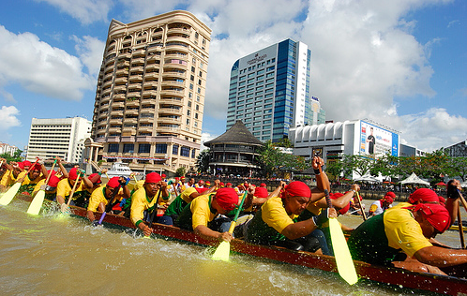
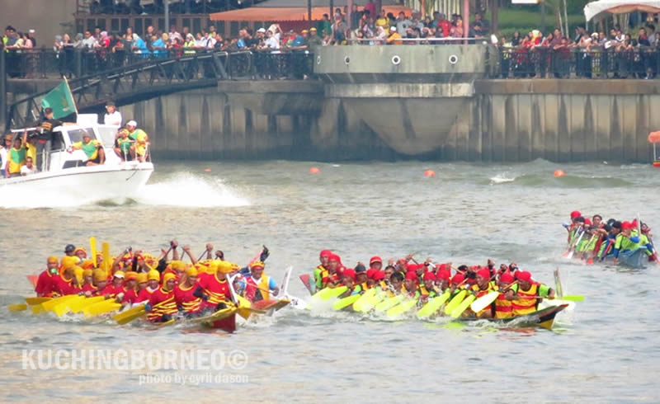
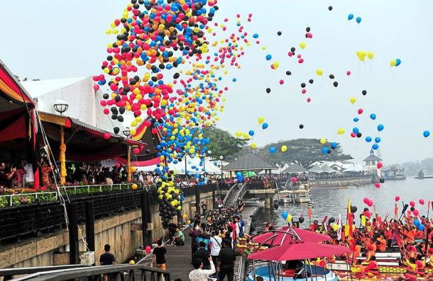
Annual Regatta

Slide 13
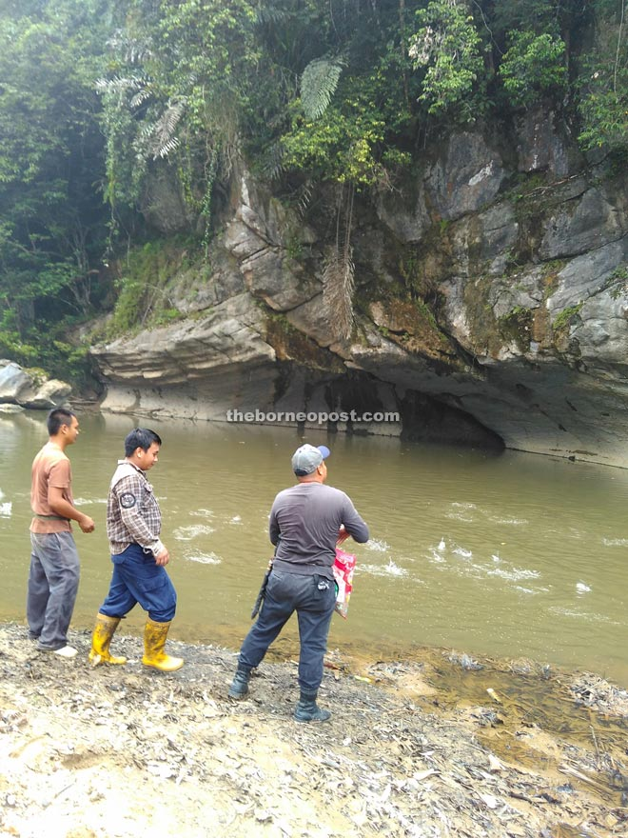
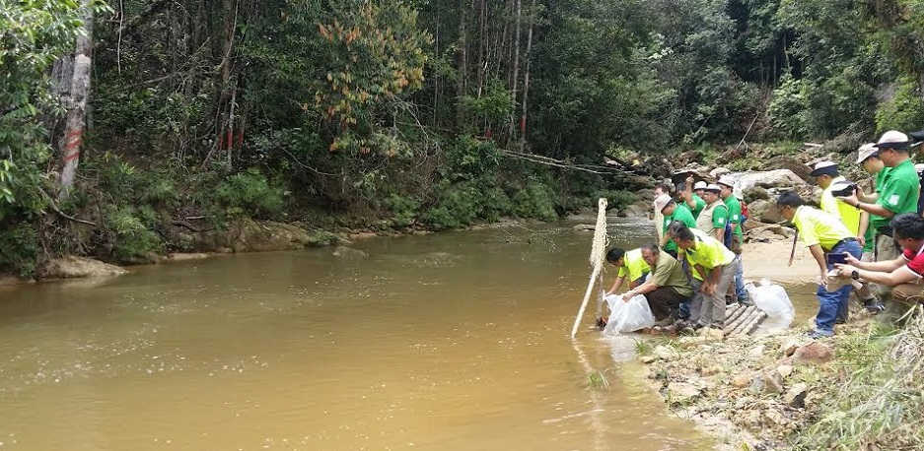
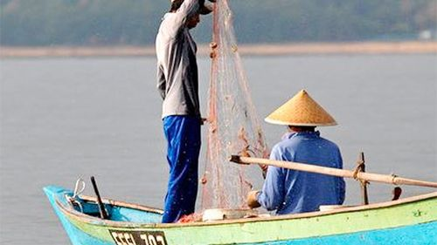
Tagang System

Slide 14
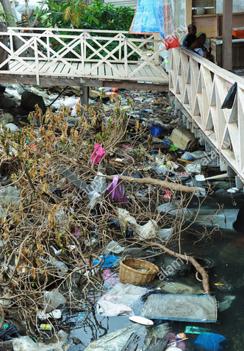
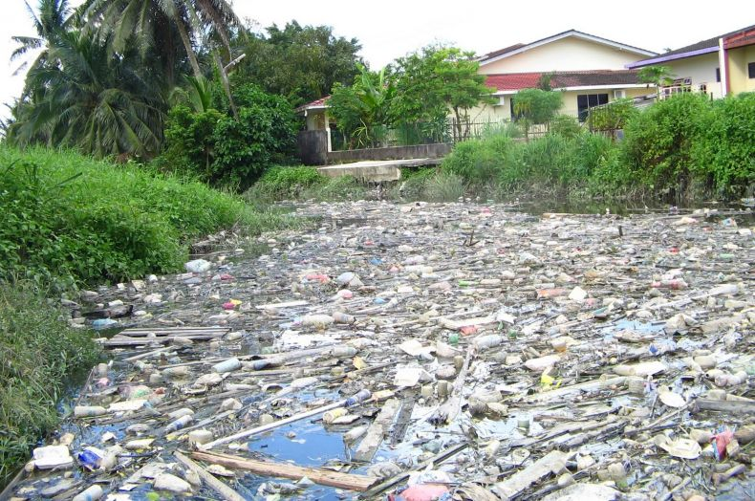

Slide 15
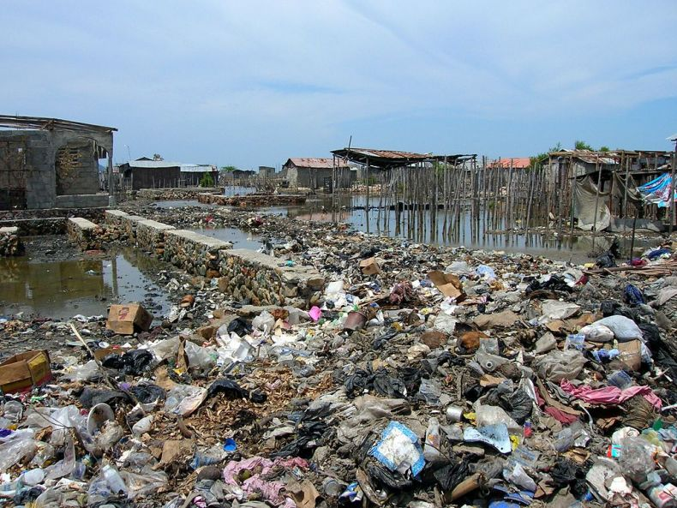

Slide 16
In a nutshell, the following activities taking place in Kuching and in Sarawak have resulted in the degradation of the water quality of many of its rivers:
-clearing of forests and natural vegetation for agriculture activities
-timber harvesting
-excessive use of fertilizers and pesticide with the development of agriculture plantations in peat swamp forest
-urban developments such as housing, commercial and industrial complexes
-Infrastructure development such as road construction
-untreated waste water and raw sewage discharge
-illegal dumping of waste
(Source: 6th SITE Research Seminar, 13-14 September 2001 Paper 9: River Water Quality Monitoring: Sharing Sarawak Experience)

Slide 17
RCE Kuching will have a key role of facilitating education, research and dialogues that will help address issues surrounding:
-Rivers Conservation
-Sustainable Communities Development
-Eco-Tourism
RCE Objectives:
Build a cross-sector network of organisations and individuals in the local community who are dedicated to the education of sustainable development.
Promote community awareness and proactive actions towards sustainable social, economic and environmental development
Promote collaborative research programs and innovation in the various SDGs
Integrate, deliver and expand ESD for SDGs to all levels of the community

Slide 18
RCE KUCHING
VISION
RCE Kuching supports transformative education for the translation of the global SDGs into the local context.

Slide 19
RCE KUCHing
MISSION
1. RCE Kuching prepares leaders of tomorrow for SDGs in local communities
2. RCE Kuching advocates and supports sustainable development of local communities
3. RCE Kuching transforms the delivery of education for sustainable goals through its collaboration and programs.

Slide 20
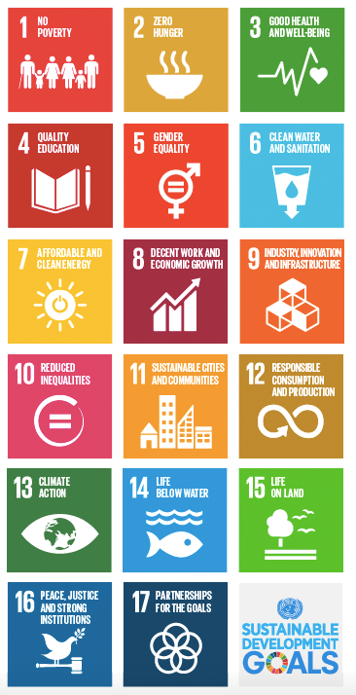
LINK to UN’s SD GOALs
RCEs can provide the building blocks towards meeting SDGs:
-SDG 4 – Quality Education
-SDG 6 – Clean Water and Sanitation
-SDG 11 - Sustainable Cities and Communities
-SDG 15 – Life on Land

Slide 21
form strategic partnerships, internally & externally
Strategic Partners KCH
Targeted Schools in Padawan
Riverine Villages in Padawan
Institutions of Higher Learning
Sarawak River Board
Natural Resources and Environment Board (NREB)
Ministry of Tourism, Arts, Culture, Youth and Sports Sarawak

Slide 22
form strategic partnerships, internally & externally
Strategic Partners KCH
Sarawak Forestry Department
WWF-Malaysia
Malaysian Nature Society (MNS)
Sarawak Biodiversity Centre
Champions Kuching
Junior Chamber International
Local Councils – DBKU, MBKS, MPP
Worming Up
Champions
Sarawak Economic Development Council
Ministry of Education, Science and Technological Research, Sarawak

Slide 23
RCE Kuching Approach
1
CHALLENGES
- River Conservation
-Eco-Tourism
-Development of Sustainable Communities
2
INPUT
-Program development
-Research
-Networking
-Capacity Building
5
Results
A thriving Kuching
4
OUTPUT
-individuals and organizations with new perspectives about sustainability, new Mindsets, Thought-Processes
3
INTERVENTIONS
-Educational Programs
-Conferences
-Forums
-Public Engagements
-Publications

Slide 24
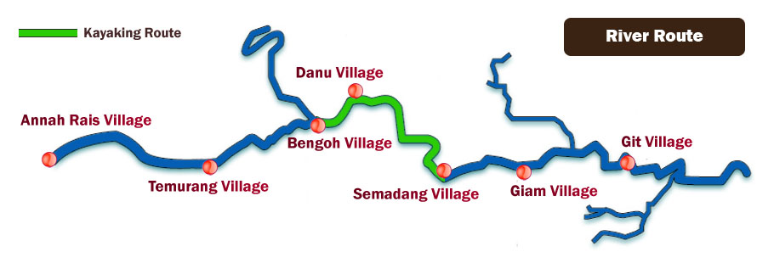
RIVERINE Communities of focus
5 Riverine communities and schools along Sarawak River (Kiri) identified
Villages | Schools in Vicinity
Kpg Annah Rais | SMK Padawan
Kpg Bengoh | SK Bengoh
Kpg Danu | SK St Paul
Kpg Semedang | SK St Patrick
Kpg Giam | SMK Siburan

Slide 25
Planned activities and PROJECTS
Public Awareness and Community Educational Programs on Rivers and related SDGs
Workshops/seminars for the community, identified villages identified. Identified Focus Area: Padawan
Volunteerism – Community-based activities for cleaning of river and its surroundings
Sustainable Waste Management Workshops for housewives
Show casing sustainable indigenous culture

Slide 26
Planned activities and PROJECTS
‘River for Everybody’ School Programme
6Rs campaign – Refuse, Reduce, Reuse, Repurpose, Recycle & Regenerate
Clubs Formation
Awareness Surveys
River Art
River Cleaning Initiatives
Initiate RCE Youth Ambassador Program in schools and higher education institutions
Green Schools

Slide 27
Planned activities and PROJECTS
Research and Development-identify potential research areas
Water Quality
Engage with MOE on inclusion of ESD in formal curricula

Slide 28
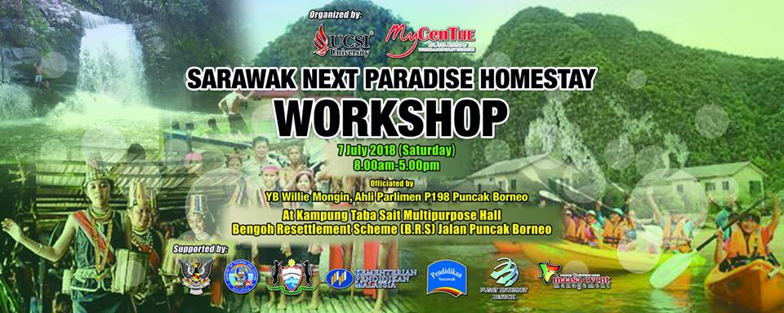

Slide 29
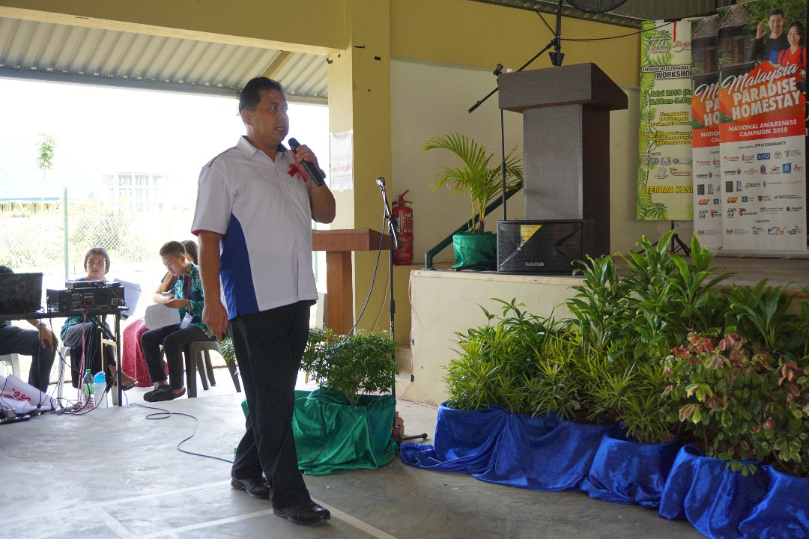

Slide 30
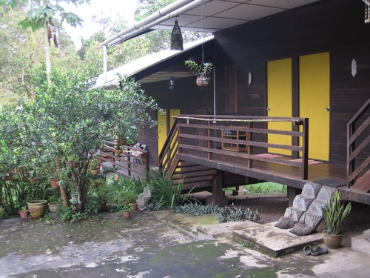
KURAKURA Homestay - Own water supply and solar energy to power lights and a fridge.

Slide 31
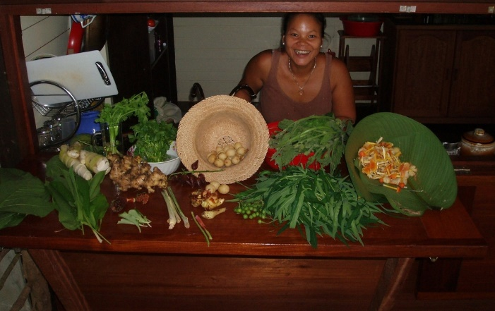
KURAKURA Homestay - Own water supply and solar energy to power lights and a fridge.

Slide 32
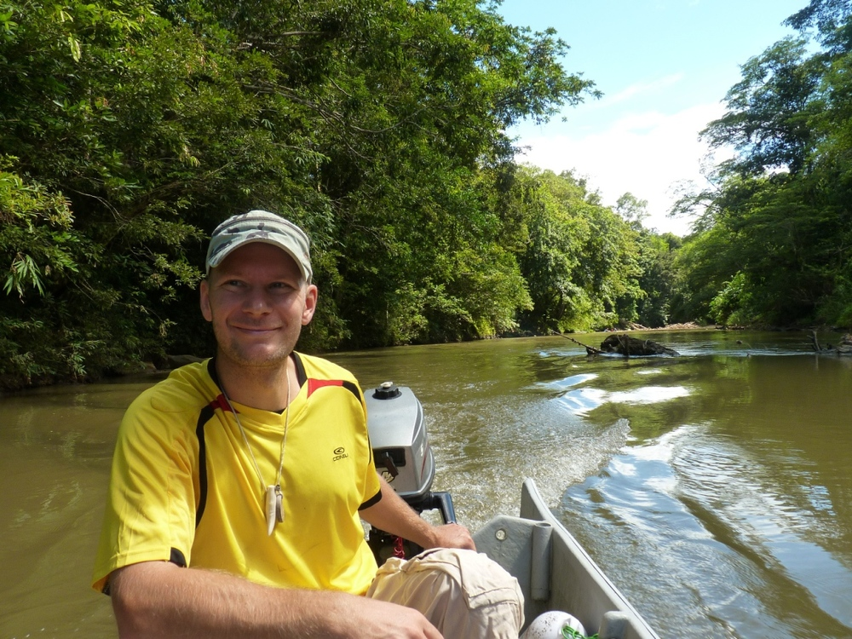
KURAKURA Homestay - Own water supply and solar energy to power lights and a fridge.

Slide 33
Eco-Tourism River Project
SDG 15 Life on Land
Objective: Promote collaborative research and innovation in the various aspects of sustainability
Project | Eco-Tourism River Project
SDG Goal & Target | SDG 15 Life On Land: Targets: 15.1 - By 2020, ensure the conservation, restoration and sustainable use of terrestrial and inland freshwater ecosystems and their services, in particular forests, wetlands, mountains and drylands, in line with obligations under international agreements 15.2 - By 2020, promote the implementation of sustainable management of all types of forests, halt deforestation, restore degraded forests and substantially increase afforestation and reforestation globally
Partners | 1. RCE Kuching: Education and Programmes/Events taskforce | 2. UCSI University – Faculty of Hospitality and Tourism Management | 3. Riverine Communities | 4. Local Council | 5. Ministry of Tourism, Arts, Culture, Youth and Sports, Sarawak (MTACYS)
Roles and functions of partner | Coordinate | Planning and Project Proposal To facilitate funding from PSIF, MTACYS | 3.1 To jointly participate in developing and implementing the project
Description (topics) | The RCE will develop an area rife in tourism activities and develop sustainable entrepreneurship avenues for the local communities in the area (along Sarawak River – Kiri). The RCE will aim to make the river a ‘River for Everybody’ raising awareness on the importance of enhancing the conservation and sustainable use of rivers and their resources including the sustainable management of fishing and tourism.
Learners | Riverine Communities hosting tourism products
Learning Objectives | Cognitive Learning LO – The learner understands basic ecology with reference to local and global ecosystems, identifying local species and understanding the measure of biodiversity Socio-emotional LO – The learner is able to connect with their local natural areas and feel empathy with non-human life on Earth Behavioral LO - The learner is able to connect with local groups working toward biodiversity conservation in their area
Learning methods | Map tourism products in area, explore entrepreneurship opportunities with villagers and run an etiquette workshop ( Community-Based)
Outcomes | Encourage actions by relevant bodies Well-developed and sustainable tourism products Local communities trained with proper etiquette, entrepreneurship skills, sustainability literate Pioneer project that can be replicated to other areas and communities
Timeline | Identify area and explore entrepreneurship opportunities – August 2018 | Develop programme in consultation with relevant authorities Sept – Dec 2018 | Implement Programme Jan 2019
Evaluation | Document participation, attendance, tourist arrivals; Pre and Post Surveys by tourists
From Prof Kashif, Dean, FHTM

Slide 34
SDG 11 Sustainable Cities and Communities
Socio-Cultural, Economic Impact of Tourism Activities
Objective: Promote collaborative research and innovation in the various aspects of sustainability
Project | Socio-Cultural, Economic Impact of Tourism Activities
SDG Goal & Target | SDG 11 Sustainable Cities and Communities Target 11.4 - Strengthen efforts to protect and safeguard the world’s cultural & natural heritage
Partners | 1. RCE Kuching: Education and Program taskforce | 2. UCSI University, Sunway College, UiTM, UNIMAS – Selected students and Academic Team | 3. Key villagers from 5 selected kampungs. | 4. NGO partners(WWF, Worming up etc) | 5. Government sectors (Ministry – MOSTI), NREB
Roles and functions of partner | Organize think tank meetings. | Generate ideas for potential research ideas and community projects.
Description (topics) | The Think Tank Team helps the villagers to solve their community’s problems via utilizing on the team’s unique resources, skills, and expertise. In addition, the team works together to come up with potential research projects and programs that will benefit our Sungai Sarawak Kiri. The research projects could be presented in the proposed RCE Forum.
Learners | University students and academic staff, and villagers.
Learning Objectives | Cognitive LO: The communities will understand the various benefits the programs will offer them Social-emotional LO: The communities will participate in all the programs Behavioral LO: The communities will be able to plan and implement eco-tourism activities which will contribute to better income for them in a sustainable manner.
Learning methods | Collaborative discourse.
Outcomes | To come up with solutions for real problems faced by the community in the 5 selected villages in Sungai Sarawak Kiri. To initiate collaborations among the partners on future research projects.
Timeline | Third Quarter 2018 Inform and invite RCE partners and communities on the Think Tank Team | Final quarter of 2018 Organize first Think Tank session | Jan 2019 Implement Projects
Evaluation | Survey, Findings, economic impart, Tourist Surveys
From Prof Kashif, Dean, FHTM

Slide 35
River Art Competition
SDG 4 Quality Education
Objective: Develop ESD learning opportunities at all levels of the community
Project | River Arts Competition
SDG Goal & Target | SDG 4 Quality Education; Target 4.7 [By 2030, ensure that all learners acquire the knowledge and skills needed to promote sustainable development, including, among others, through education for sustainable development and sustainable lifestyles, human rights, gender equality, promotion of a culture of peace and non-violence, global citizenship and appreciation of cultural diversity and of culture’s contribution to sustainable development]
Partners | RCE Kuching i) Events Taskforce ii) Education & Programme Taskforce iii) Evaluation / Review Taskforce | UCSI University Faculties & Student Affairs & Alumni |  | Public & Private Universities & Colleges Students Lecturers Library |  | Schools (Primary & Secondary) Students Teachers | WWF-Malaysia
Roles and functions of partner | Develop and coordinate programme as a whole Provide advice and guidance to all partners Gather Report Evaluate / Review | Assist in student volunteers Provide assistance to organize the competition Providing information Assist in sales & promotion Assist in sponsorship |  | Assist in sales and promotion of competition Assist in finding participants Assist in sponsorship Assist in student volunteers |  | Assist in finding participants Provide any types of support | Providing information Support in the activities through talk, workshop, seminar & competition Providing guidance, advice & mentor for the activities Assist in sponsorship
Description (topics) | An exciting art competition that adds unique perspectives of communities on river sustainability and how their expressions could be portrayed in the forms of various arts exhibitions such as drawing, work displays and coloring.
Learners | University/college students, primary & secondary school students, open entry
Learning Objectives | The learners will understand the importance of Sarawak rivers sustainability. (Cognitive learning) The learners are able to express their feelings about Sarawak rivers sustainability in the form of arts among local communities. (Socio-emotional learning) The learners are able to connect with various people to spread the news on Sarawak rivers sustainability (Behavioral learning)
Learning methods | Organize art competition
Outcomes | The learners aware about Sarawak rivers sustainability. The learners produce an art creation that will touch the heart of various stakeholders towards Sarawak rivers sustainability. The learners create networking that will pursue extended efforts towards Sarawak rivers sustainability.
Timeline | Development phase (6 months) Develop proposal Consult with relevant agencies/bodies Obtain approval from relevant stakeholders |  | Awareness phase (6 months) Promotion, marketing Invite participants |  | Implementation phase (1-day event) River Art Competition take place on decided place, day and time
Evaluation | Survey form on program effectiveness in creating river sustainability awareness Total participants and supports received
From Lucas, Lecturer, ICAD

Slide 36
Water Quality
SDG 6 Clean Water and Sanitation
RCE : Promote collaborative research and innovation in the various aspects of sustainability
Project | River Water Quality
SDG Goal & Target | SDG 6 Clean Water and Sanitation
Partners | 1. RCE Kuching: Education and Programme taskforce | 2. UCSI University, FPS & CERVIE | 3. NREB
Roles and functions of partner | 1.1 To facilitate and coordinate the universities and NGOs in the research project | To develop research project proposal, methods, data collection and reporting To facilitate funding from PSIF | 3.1 To jointly participate in developing and carry out the research project
Description (topics) | This project will involve getting the necessary water quality data from strategic points of the Sarawak River.
Learners | Researcher, research students and communities
Learning Objectives | Cognitive LO: Staff and students are aware of the issues with the river water quality in the Sarawak river Social-emotional LO: able to carry out research work in the analysis of the river water Behavioral LO: plan, implement and share research outcomes in conferences, research journals and through the Knowledge-Transfer-Programme
Learning methods | To develop partnership between NGOs, communities and universities in planning and running a research project in water quality
Outcomes | research outcomes in conferences, research journals and through the Knowledge-Transfer-Programme
Timeline | July – Dec 2018 | Jan – June 2019 | July 2018 – July 2020
Evaluation | Findings, sharing at forum
From Dr. Lokesh, Assistant Professor, FPS

Slide 37
RCE Youth Ambassador Programme
SDG 4 Quality Education
Target 4.7
Objective: To develop the learning objectives, outcomes, pedagogy and assessment of the RCE Youth Ambassador Programme Conduct and share research and innovative practices in sustainability education to promote partnerships, learning and advancements in the restoration of the Sarawak River
Project | RCE Youth Ambassador Programme
SDG Goal & Target | SDG 4 Quality Education; Target 4.7 [By 2030, ensure that all learners acquire the knowledge and skills needed to promote sustainable development, including, among others, through education for sustainable development and sustainable lifestyles, human rights, gender equality, promotion of a culture of peace and non-violence, global citizenship and appreciation of cultural diversity and of culture’s contribution to sustainable development]
Partners | 1. RCE Kuching: Education and Programme taskforce | 2. UCSI University, SAA & FOSSLA | 3. Student bodies of UCSI | 4. Student bodies of UNIMAS | 5. Student bodies of Swinburne
Roles and functions of partner | 1.1 To develop the learning objectives, outcomes, pedagogy and assessment, working together with the other RCE teams, student groups, SAA & Academic Office | To advise and implement the inclusion of ESD-SDG education in the current ELE subject and University Life subject | 3.1 To participate in developing the Youth Ambassador Programme 3.2 To participate in the training programme
Description (topics) | Course content will focus on the 4 SDG Goals and specific targets as identified in the RCE Kuching
Learners | University students of UCSI, UNIMAS, Swinburne and Sunway; the programme will be extended to other universities in stages
Learning Objectives | Cognitive LO: Students are aware and develop the skills of SDG Social-emotional LO: Students are able to articulate and raise awareness of SDGs among their peers Behavioral LO: Students plan and implement SDG projects in schools or communities
Learning methods | To develop partnership between schools and universities in planning and running a SDG project in the schools or community; e.g. the 3 Rs and water conservation projects
Outcomes | Students will be equipped with the knowledge, skills and value of SDGs and to extend their knowledge to the schools and communities; they will be role model of other students on campus; they will train future youth ambassador in order to sustain the SDG goals in their campuses
Timeline | July – Dec 2018 | July – Dec 2018 | Jan – June 2019 and onwards
Evaluation | To develop instrument in assessing the knowledge, skills and value of students in SDGs before and after the programme; purpose is to assess success of the programme towards SDG Goal 4 and Target 4.7

Slide 38
RCE Kuching Committee
Chairperson
Vice-Chair
Secretariat
Assoc Prof Dr Yeong SW
Madam Mukvinder Sandhu
Ting Nyik Eing
Genevie Rural Mikal
Stakeholder-Advisory Committee
Governance and Management
Programmes
Regional workshop/ conferences/ meeting
Education and Research
RCE-SDG Ambassador Programme
Project on water quality, sustainable fishing and eco-tourism
Outreach & Engagement
Fund raising projects
Evaluation & Review
Publicity & communication
Stakeholder meetings
Reports
Info and data collection
Evaluate & analyse to ensure projects meet objectives
TASK FORCES of RCE KUCHING

Slide 39
RCE Governance and Management Team
Chairperson: Assoc Prof Dr Yeong Siew Wei
Vice-Chairperson: Mukvinder Sandhu
Secretariat: Ting Nyik Eing, Genevie Mikal
Taskforces:
Events – Taskforce Chairperson: Francesca Enchang (FHTM); Vice-Chairperson: Sherrymina Kichin (FHTM)
Members: Agnes Toner
Education and Programmes – Taskforce Chairperson: Prof Kashif Hussain (FHTM); Vice-Chairperson: Azizan bin Yatim (CPU)
Members: Irene Kho, Sim Pei Lin, Tan Sze Leng
Outreach and Engagement – Taskforce Chairperson: Bernard Jussem (FHTM); Vice-Chairperson: Joseph Martin (FHTM)
Evaluation and Review – Taskforce Chairperson: Dorothy Dzrandimay (Library); Vice-Chairperson: Dr Rabaah Tudin (FOBIS)

Slide 40
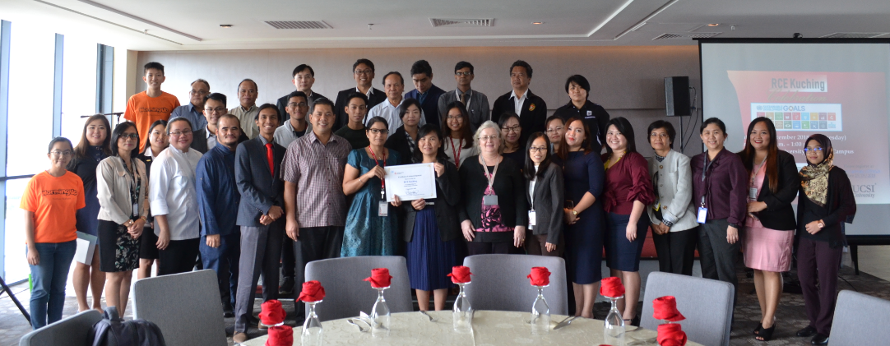
Thank You
“Education can, and must, contribute to a new vision of sustainable global development” (UNESCO. 2015)

